Slide 1
RDBMS Concepts

Slide 2
What is Data/Information ?
Information is one that has meaning in some context for its receiver.
When information is entered into and stored in a computer, it is generally referred to as data.
After processing (such as formatting and printing), output data can again be perceived as information.

Slide 3
What is a database?
A database is a collection of information (related data) that is organized so that it can easily be accessed, managed, and updated.
Ex: The names, telephone numbers & address of all the people you know

Slide 4
What is DBMS ?
DBMS is a software system that facilitates the creation and maintenance and use of an electronic database
The general purpose of a DBMS is to provide for the definition, storage, extraction and management of data in a centralized area that can be shared by many users
Layer of abstraction between the application programs and the file system
Note : Application programs request the DBMS to retrieve,
  modify, insert or delete data for them

Slide 5
Modern day Computer-based Information Systems (IS) are capable of serving a variety of complex tasks in a coordinated manner. Such systems handle large volumes of data, multiple users and several applications for activities occurring in a central and/ or distributed environment.
The heart of an IS is Database Management. This is because most IS have to handle massive amounts of data. This core module of an IS is called as Database Management System (DBMS). A DBMS provides for storage, retrieval and updation of data in an organized manner.
An Example: Consider the situation in a library. Here, we have data corresponding to books, authors, suppliers, borrowers, etc. The total volume of data stored and handled in a library may be quite large. The Library DBMS may require several operations such as issue, return or purchase of books; handle queries relating to book information, borrowing information, etc. Moreover, there are different types of users who operate various stages or activities. For example, a borrower may merely view certain information, whereas an issuer may be allowed to update the status of a book during issue or return. The Library staff may on the other hand add new books, their supplier, price and other information to the database. Each user category has a different access right on both the data as well as the processing capabilities. Multiple users may concurrently operate the Library DBMS performing several tasks at the same time. They may even try to access the same data simultaneously. It is the job of a DBMS to handle the data and its processing in an integrated, coordinated and consistent manner. Finally, the Library DBMS must have mechanisms to handle system failure (e.g., failure of power, disk crash, etc.) so that the database can be recovered to a consistent state.

Slide 6
Services provided by a DBMS
  •Data definition
  Data management
  •Transaction support
  •Concurrency control
  •Recovery
  •Security & integrity
  •Utilities- facilities like data import & export, user management, backup, performance analysis, logging & audit, physical storage control

Slide 7
RDBMS
In short an RDBMS is a DBMS in which data is stored in the form of relations (tables-nothing but tables) and the relationship among the data is also stored in the form of tables.
In RDBMS every piece of information is stored in the form of tables. When you create a table, information about that table ie., owner name, table name, column names, data types, constraints, privileges etc are also stored in another set of tables called data dictionary tables (metadata).

Slide 8
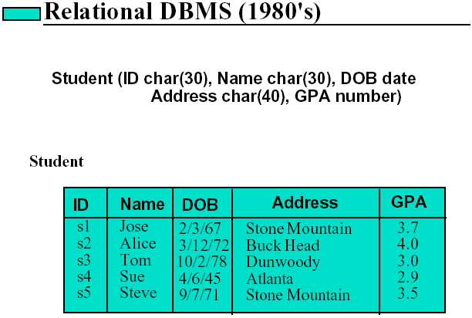
RDBMS terminologies
Relation/Table
Attribute/column/field
Tuples/Record/Row
Domain

Slide 9
Keys
Primary key
The candidate key that is chosen to perform the identification task is called the primary key and any others are alternate keys
Every tuple must have, by definition, a unique value for its primary key.
A primary key which is a combination of more than one attribute is called a composite primary key
Foreign key
•A foreign key is a “copy” of a primary key/unique key that has been exported from one or more column/s (parent column/s) of one table into another column/s of same or another table to represent the existence of a relationship between them.

Slide 10
A foreign key is a copy of the whole of its parent key i.e if the primary key is composite, then so is the foreign key
•Foreign key values do not (usually) have to be unique
•Foreign keys can also be null
•A composite foreign key cannot have some attribute(s) null and others non-null

Slide 11
Functional dependency (FD)
A Functional Dependency describes a relationship between attributes in a single relation.
An attribute is functionally dependant on another if we can use the value of one attribute to determine the value of another.
We use the symbol -> to indicate a functional dependency.
-> means functionally determines
Examples :
destination -> fare
The attributes listed on the left hand side of the -> are called determinants.
One can read A -> B as, "A determines B".

Slide 12
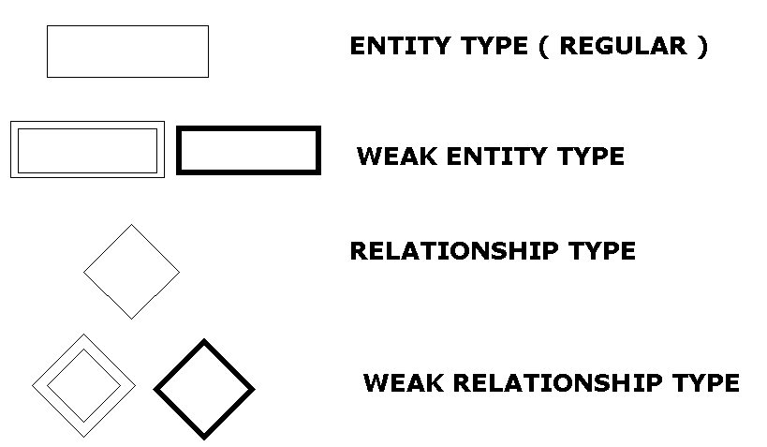
E- R Modeling : Notations

Slide 13
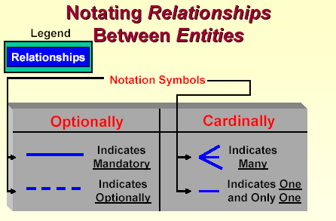

Slide 14
Simple E-R diagram
Tutor number
Name
Address
Subjects taught
TUTOR
Attributes
teaches on
Title
Examinations available
Entity
COURSE
attended by
Relationship
Student enrolment number
Name
Address
Telephone number
Subjects studied
STUDENT

Slide 15
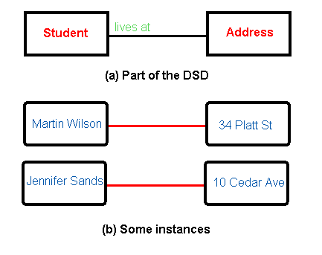
Types of relationship
Cardinality (Numeric relationship between entities)
1. One-to-one relationships : One student may live at only one address

Slide 16
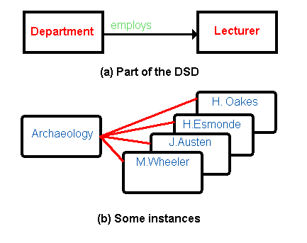
2.One-to-many relationships :
One department may employ many lecturers

Slide 17
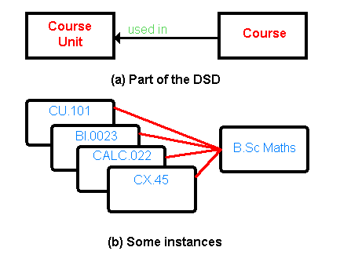
3. Many to one relationship :
Many course units may be used in one course

Slide 18
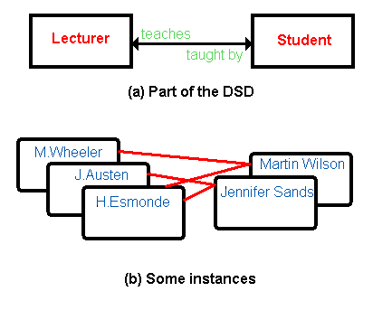
4. Many-to-many relationships:
One lecturer may teach many students, and one student may be taught by many lecturers

Slide 19
In practice, only two relationships need be used on data structure diagrams:
One-to-one
One-to-many
A many-to-many relationship can be resolved into two one-to-many relationships by means of a third entity.
Thus, instead of the many-to-many relationship shown in Previous figure – which tells us that one Lecturer may teach many Students, and one Student may be taught by many Lecturers – we would resolve this into two one-to-many relationships by the introduction of a third link Lecturer-Student entity.

Slide 20
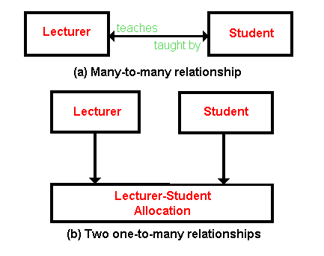

Slide 21
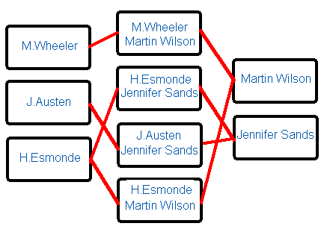
Some possible physical occurrences of the Lecturer-Student relationship are shown

Slide 22
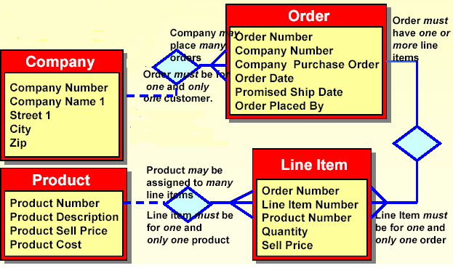
E-R Diagram example

Slide 23
COMPANY
ORDER
cno | cname | street | city
C1 | WIPRO | GUINDY | CHENNAI
C2 | IBM | B’GATTA Rd | BLORE
C3 | ACCEN | TIDEL PARK | CHENNAI
ord_no | cno | ord_date | ship_date
101 | C1 | 12-FEB-87 | 15-FEB-87
102 | C3 | 25-JUN-90 | 02-JUL-90
103 | C1 | 29-AUG-92 | 05-SEP-92
PRODUCT
LINEITEM
prodid | prodname | sellprice | costprice
P1 | Mouse | 350 | 300
P2 | Keyboard | 400 | 360
P3 | CPU | 4900 | 4200
P4 | 512MB RAM | 550 | 520
P5 | 1GB RAM | 1000 | 930
P6 | Mother Board | 5400 | 4900
ord_no | lineno | prodid | qty | sellprice
101 | 1 | P1 | 2 | 350
101 | 2 | P2 | 3 | 400
101 | 3 | P5 | 1 | 1000
102 | 1 | P2 | 3 | 400
103 | 1 | P3 | 1 | 4900
103 | 2 | P6 | 1 | 5400

Slide 24
Normalization
Normalization & Normal Forms
Why Normal Forms ?
Evils of redundancy
First Normal Form(1NF)
Partial Dependency
Second Normal Form(2NF)
Transitive Dependency
Third Normal Form(3NF)
Exercise

Slide 25
Normalization & Normal Forms
Normalization
  Decomposing a larger, complex table in simpler, smaller ones.
  Move from lower normal forms to higher normal forms
Note: Don’t include computed fields
Normal Forms
  First normal form(1NF)
  Second normal form(2NF)
  Third normal form(3NF)
  Higher normal Forms(BCNF, 4NF, 5NF,…)
  Note : In practice 3NF is good enough

Slide 26
Why Normal Forms?
In order to produce good database design, we should ask questions like:
Does this design ensure that all database operations will be efficiently performed and that the design does not make the DBMS perform expensive consistency checks which could be avoided?
2) Is the information unnecessarily replicated?
Unless these issues are properly handled several difficulties like redundancy and loss of information may arise. There are several methods to avoid the above mentioned problems. One such method is database decomposition through normalization, which tries to minimize redundancy and the efforts of checking of constraints and dependencies.

Slide 27
Evils of Redundancy
Redundancy is at the root of several problems associated with relational schemas
More seriously, data redundancy causes insert, update and delete anomalies.
Wastage of Storage

Slide 28
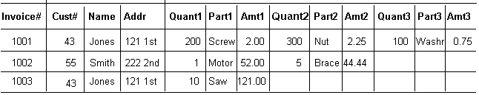
FIRST NORMAL FORM
Reduce entities to first normal form (1NF) by removing repeating or multivalued attributes to another, child entity
Separate Repeating Groups into New Tables.
Repeating Groups: Fields that may be repeated several times for one document/entity
Create a new table containing the repeating data
The primary key of the new table (repeating group) is always a composite key; Usually document number and a field uniquely describing the repeating line, like an item number.

Slide 29
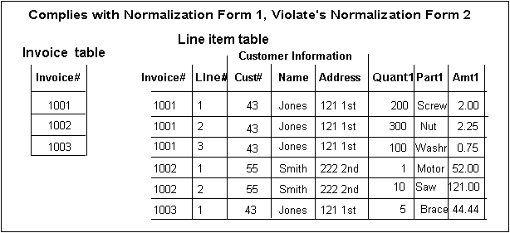
Relation in 1NF

Slide 30
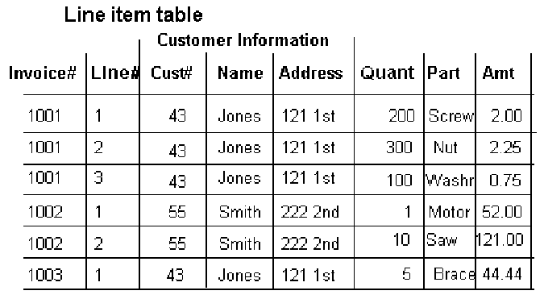
Second Normal Form
Reduce first normal form entities to second normal form (2NF) by removing attributes that are not dependent on the whole primary key (partial dependency)

Slide 31
Normalization: Second Normal Form
  Remove Partial Dependencies.
  Functional Dependency The value of one attribute in a table is determined entirely by the value of another.
  Partial Dependency A type of functional dependency where an attribute is functionally dependent on only part of the primary key (primary key must be a composite key).
  Create separate table with the functionally dependent data and the part of the key on which it depends. Tables created at this step will usually contain descriptions of resources.

Slide 32
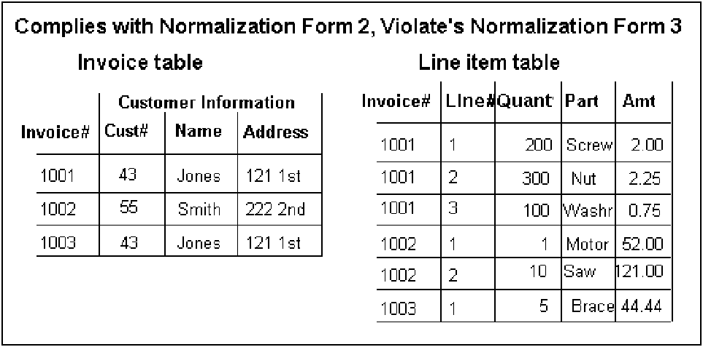
Relation in 2NF

Slide 33
Transitive dependency
An attribute in a table is dependent on another non primary key attribute rather than the primary key.
A condition where A, B, and C are attributes of a relation such that
if A -> B and B -> C
then C is transitively dependent on A via B i.e, A->C is a transitive dependency.
This situation is eliminated when the table is in third normal form.

Slide 34
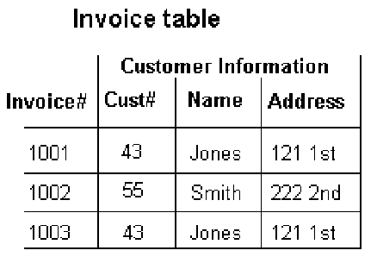
Third Normal Form
A relation is in third normal form (3NF) if it is in second normal form and it contains no transitive dependencies.
OR
Reduce second normal form entities to third normal form (3NF) by removing attributes that depend on other, nonkey attributes.

Slide 35
Normalization: Third Normal Form
Remove transitive dependencies.
Transitive Dependency A type of functional dependency where an attribute is functionally dependent on an attribute other than the primary key. Thus its value is only indirectly determined by the primary key.
Create a separate table containing the attribute and the fields that are functionally dependent on it. Tables created at this step will usually contain descriptions of either resources or agents. Keep a copy of the key attribute in the original file.

Slide 36
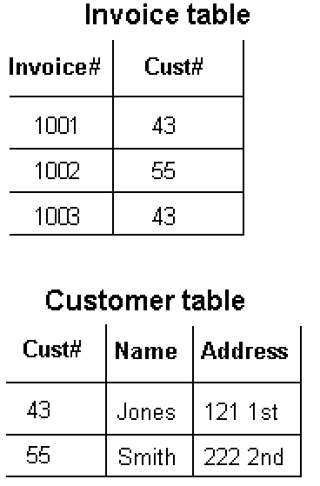
Decomposed into 3NF

Slide 37
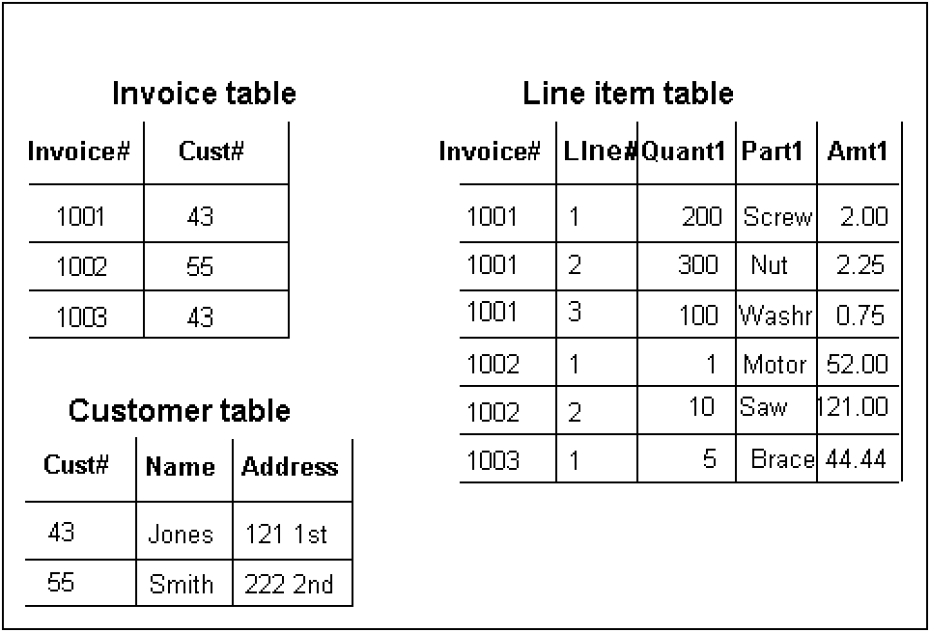
All the tables

Slide 38
Exercise:
Normalize following table structure:
stud_fname, stud_lname, stud_address, stud_dob,percentage, admission_date, branch_name, branch_course_duration, staff_name, staff_address, dateofjoin, staff_experience,salary, staff_designation(job_type), subjects_handled
Assume it is a college database which offers B.E in various branches like
ELECTRONICS,ELECTRICAL,CIVIL,COMPUTER SCIENCE,ARCHITECTURE etc. ,
Note :Consider the points placed in next slide before naming structures

Slide 39
1. Add columns where ever required.
2. Mention PK and FK columns
3. A student can choose only one branch
4. A staff belongs to only one branch
5. A staff may handle more than one subject
6. One subject may be handled by more than one staff.
7. Their may be a case where you don't have staff for one or more subjects.
8. A staff may handle subject for another branch also (no need for allocation).
9. We should be able to find the subjects under each branch.
10. Same subject may be present in more than one branch.
11. No need to know the allocation of staff to various class etc.,

Slide 40
Oracle 10g Database Server
SQL
(Structured Query Language)

Slide 41
Oracle Database Management Tools
SQL (sequel) – Structured [English] Query Language
Standard Language for Managing almost any RDBMS
Supports with set of commands for managing RDBMS
Developed by IBM
Based on Dr. E F Codd’s Relational Model
PL/SQL – Procedural Language/SQL
-Procedural extension to SQL
-Provides with programming language features using which you can develop application logic programs like procedures, functions, triggers and packages which will be stored on database server.

Slide 42
Oracle Database Access Tools
SQL*Plus (most widely used tool)
- an interactive tool which takes SQL statements and PL/SQL programs from you and sends to oracle for execution
- results and errors given by oracle will be presented in default format or in specific format specified.
supports many report formatting commands, environment commands which are useful in presenting data in desired format, setting the environment, saving statements and PL/SQL programs in files, spooling etc.,
iSQL*Plus (web browser tool)
http://<hostname:5560>/isqlplus
SQL*Plus worksheet - quite similar to SQL*Plus/iSQL*Plus

Slide 43
SQL command Groups
Data Query Language (DQL) statement used querying database
SELECT - used to retrieve the data present in the database
Data Definition Language (DDL) statements are used to define the database structure or schema.
CREATE - to create objects in the database
ALTER - alters the structure of the database
DROP - delete objects from the database
TRUNCATE - remove all records from a table permanently
COMMENT - add comments to the data dictionary
RENAME - rename an object

Slide 44
Data Manipulation Language (DML) statements are used for managing data within schema objects.
INSERT - insert data into a table
UPDATE - updates existing data within a table
DELETE - deletes unwanted/all records from a table
MERGE - UPSERT operation (insert or update)
Data Control Language (DCL) statements are used for granting and denying access privileges to other users
GRANT - gives user's access privileges to database
REVOKE - withdraw access privileges given with the GRANT command
Transaction Control (TCL) statements are used to manage the changes made by DML statements. It allows statements to be grouped together into logical transactions.
COMMIT - save work done
ROLLBACK - restore database to original since the last COMMIT
SAVEPOINT - identify a point in a transaction to which you can later roll back

Slide 45
Simple SELECT command syntax
SELECT (attributes )
FROM (table names )
WHERE (row restriction)
GROUP BY (attributes)
HAVING (group restriction)
ORDER BY (attributes)

Slide 46
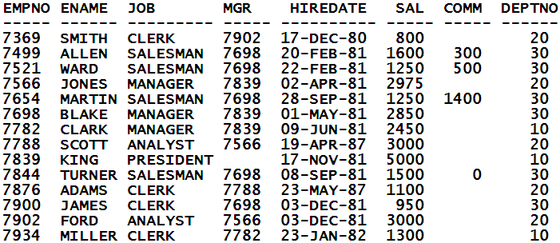
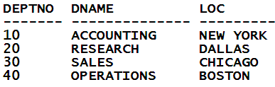
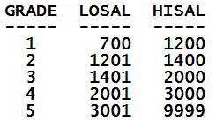
Sample tables
EMP
DEPT
SALGRADE

Slide 47
Login Process
Using interactive client tool SQL*Plus you can connect to oracle database.
Oracle provides with many built-in schemas like SCOTT, HR, OE, SH, SYS, SYSTEM and etc.,
SYS schema contains data dictionary information
SYSTEM schema is used for DBA purpose
SCOTT, HR, OE, SH etc., can be used for practice purpose
In our module we would be using SCOTT & HR schema.
In the login dialog box provide username, password and host string (required if you connect to server on the network).
To know which schema you are using
SELECT user FROM DUAL;

Slide 48
To list tables, views etc., existing for current schema/user
SELECT * FROM TAB;
SELECT - command
* - all the columns
FROM - keyword
TAB – data dictionary table which displays list of all tables, views, materialized views, synonyms, cluster tables, nested tables etc for current schema.
To view structure of a table
DESC <table_name> -- SQLPLUS command
To list required columns
SELECT <col_name1>,<col_name2>,… FROM <table_name>;

Slide 49
Arithmetic operators
+ : addition
- : subtraction
* : multiplication
/ : division
( ) : to override order of precedence
Comparison operators
= : equal to
!=, <>, ^= : not equal to
< : less than
<= : less than or equal to
> : greater than
>= : greater than or equal to

Slide 50
Logical Operators
NOT : logical NOT operator
AND : logical AND operator
OR : logical OR operator
SQL operators
IN : list of values within ( )
NOT IN : negation of IN
BETWEEN : range of values
NOT BETWEEN : negation of BETWEEN
LIKE : using “%” and “_” as meta characters
NOT LIKE : negation of LIKE
IS NULL : evaluating NULL’s
IS NOT NULL : negation of IS NULL

Slide 51
Examples
SELECT ENAME,JOB,SAL,DEPTNO FROM EMP;
Arithmetic operation
SELECT ENAME,JOB,SAL,(SAL+250)*12 FROM EMP;
Alias column heading
SELECT EMPNO,ENAME AS EMPNAME,JOB DESIG,SAL Salary,(SAL+250)*12 "Annual Salary" FROM EMP;
Concatenation operator (||)
SELECT ENAME,JOB,ENAME||JOB FROM EMP;
SELECT ENAME||' works as '||JOB "EMP JOB" FROM EMP;
Quote operator : 10g feature
SELECT ename|| q'[, employee's salary is: ] '|| sal FROM EMP;

Slide 52
DISTINCT clause : to avoid duplicated from being displayed
SELECT DISTINCT DEPTNO FROM EMP;
Handling NULL’s
SELECT ENAME,SAL,COMM,SAL*12+COMM FROM EMP;
NVL ()
SELECT ENAME,SAL,COMM,SAL*12+NVL(COMM,0) FROM EMP;
NVL2()
SELECT ENAME,SAL,COMM,NVL2(COMM,SAL*12+COMM,SAL*12) FROM EMP;

Slide 53
Sorting – order by clause
SELECT <col_names> FROM <table_name>
ORDER BY <col_name/s>
Searching/Restricting data – WHERE clause
SELECT <col_names> FROM <table_name>
WHERE col_name/expression <operator> col_name/values
Substitution variables
& : accepts values, expression during query execution

Slide 54
Rules of Precedence
Order Evaluated Operator
1 Arithmetic operators
2 Concatenation operator
3 Comparison conditions
4 IS [NOT] NULL, LIKE, [NOT] IN
5 [NOT] BETWEEN
6 NOT logical condition
7 AND logical condition
8 OR logical condition

Slide 55
Exercise:
List all details from salgrade table.
Display different job types without duplicating
List employees in department 10 and 30 in alphabetical order of names
List clerks in department 20
List employees having ‘LL’ or ‘TH’ in their names
List employees who do not have manager.
List employees hired in year 81.
List salesmen having salary greater than commission. Sort on their salaries in descending and names ascending.
List o/p as ‘SMITH works since 17-DEC-80 as CLERK’
List employees hired during any 2 dates (use substitution variable).
11. List all clerks earning less than 1000 and all managers
12. List employees having annual renumeration > 30000

Slide 56
13. Write a query to display the name, job, mgr, hire date, and employee number for each employee, with employee number appearing first. Provide an alias STARTDATE for the HIREDATE column. Save your SQL statement to a file named lab_01.sql

Slide 57
DUAL table
The DUAL table is owned by the user SYS and can be accessed by all users.
It contains one column, DUMMY, and one row with the value X.
The DUAL table is useful when you want to return a value once only (for example, the value of a constant, pseudocolumn, or expression that is not derived from a table with user data).
The DUAL table is generally used for SELECT clause syntax completeness

Slide 58
Functions
Input
Function
Output
arg 1
Function performs action
arg 2
Result
value
arg n

Slide 59
Two Types of SQL Functions
Functions
Single-row
functions
Multiple-row
functions
Operate on single rows only and return one result per row.
Can manipulate groups of rows to give one result per group of rows (group functions)

Slide 60
Single-Row Functions
Character
Accepts
different types
Regular
Expression
Single-row
functions
Conversion
Number
Date

Slide 61
Character Functions
Character
functions
Case-manipulation
functions
Character-manipulation
functions
LOWER
UPPER
INITCAP
CONCAT
SUBSTR
LENGTH
INSTR
LPAD | RPAD
LTRIM | RTRIM
REPLACE
TRANSLATE

Slide 62
CHARACTER functions
LOWER (string) – returns data in lower case
UPPER(string) – returns data in upper case
INITCAP(string) – returns with first character in caps for each word
CONCAT(string1,string2) – concatenates two strings
SQL> SELECT ENAME,LOWER(ENAME),UPPER('OrACle'),
INITCAP(JOB),CONCAT(JOB,SAL) FROM EMP WHERE
DEPTNO=10;
CLARK clark ORACLE Manager MANAGER2450
KING king ORACLE President PRESIDENT5000
MILLER miller ORACLE Clerk CLERK1300

Slide 63
LPAD(string,width,padding character’s ) – Right justifies the string within defined width and on LHS pads with padding char
RPAD(string,width,padding character’s ) – Left justifies the string within the defined width and on LHS pads with padding char
SQL> SELECT DNAME,LPAD(DNAME,15,'.'),
RPAD(DNAME,15,'*') FROM DEPT;
ACCOUNTING .....ACCOUNTING ACCOUNTING*****
RESEARCH .......RESEARCH RESEARCH*******
SALES ..........SALES SALES**********
OPERATIONS .....OPERATIONS OPERATIONS*****

Slide 64
SUBSTR(string,start pos,length )- returns part of the string
INSTR( string, char’s, start pos, nth occurance) – returns index of the char’s in the given string
SQL> SELECT DNAME, SUBSTR(DNAME,3,4),SUBSTR(DNAME,4),
INSTR(DNAME,'C',1),INSTR(DNAME,'C',1,2)
FROM DEPT;
ACCOUNTING COUN OUNTING 2 3
RESEARCH SEAR EARCH 7 0
SALES LES ES 0 0
OPERATIONS ERAT RATIONS 0 0

Slide 65
LTRIM(string,char’s) – returns string after trimming with specified chars from left hand side of the string
RTRIM(string,char’s) – returns string after trimming with specified chars from right hand side of the string
SQL> SELECT DNAME,LTRIM(DNAME,'ASOP'),
RTRIM(DNAME,'NGES') FROM DEPT;
ACCOUNTING CCOUNTING ACCOUNTI
RESEARCH RESEARCH RESEARCH
SALES LES SAL
OPERATIONS ERATIONS OPERATIO

Slide 66
LENGTH(string)- returns length of the string
TRANSLATE(string,source,target ) – overwrites source chars with target chars
SQL> SELECT DNAME,LENGTH(DNAME),
TRANSLATE(DNAME,'A','X'),
TRANSLATE(DNAME,'AS','XY')FROM DEPT;
ACCOUNTING 10 XCCOUNTING XCCOUNTING
RESEARCH 8 RESEXRCH REYEXRCH
SALES 5 SXLES YXLEY
OPERATIONS 10 OPERXTIONS OPERXTIONY

Slide 67
REPLACE(string,source,target) – replaces source string with target string
SQL> SELECT JOB, REPLACE(JOB,'SALESMAN','MARKETING')
FROM EMP WHERE DEPTNO=30;
SALESMAN MARKETING
SALESMAN MARKETING
SALESMAN MARKETING
MANAGER MANAGER
SALESMAN MARKETING
CLERK CLERK
CHR(number) – returns char equi of ascii value
SELECT CHR(67)||CHR(65)||CHR(84) "Dog" FROM DUAL;

Slide 68
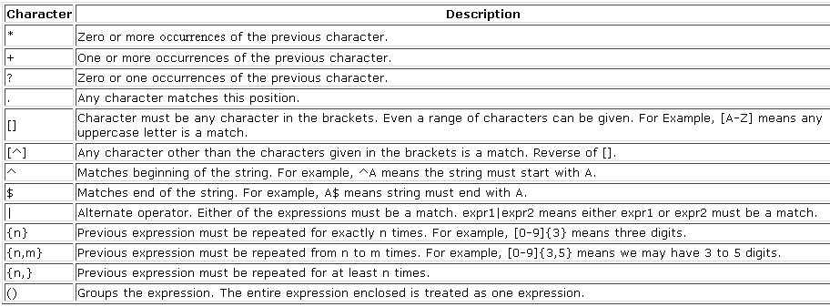
Regular Expression (10g feature)
Oracle Database 10g includes support for IEEE/POSIX standard native regular expressions in SQL
- Compatible with other programming environments such as Unix,
perl and Java
Special characters in regular expression

Slide 69
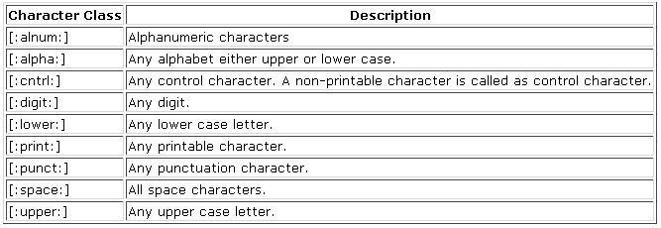
Class Operators

Slide 70
Regular Expression functions
REGEXP_LIKE Function
- Applies a LIKE function to a regular expression pattern
- Simplified Syntax:
REGEXP_LIKE (source string, pattern)
Source string specifies source data to be scanned
Pattern is the regular expression to search within the source string
- Returns true or false indicating whether the pattern matched the data.
Used primarily in the WHERE clause
SQL> SELECT * FROM DEPT
WHERE REGEXP_LIKE(LOC,'NEW');
SQL> SELECT * FROM DEPT WHERE REGEXP_LIKE(LOC,'New');

Slide 71
SQL> SELECT * FROM DEPT WHERE REGEXP_LIKE(LOC,'new','i');
SQL> SELECT * FROM DEPT WHERE REGEXP_LIKE(DNAME,'S');
SQL> SELECT * FROM DEPT WHERE REGEXP_LIKE(DNAME,‘^S');
SQL> SELECT * FROM DEPT WHERE REGEXP_LIKE(DNAME,'S$');
- Assume we have a postal code column with A9A-9A9 format for
Canadian companies
- Get all companies in Canada with a valid postal code
SELECT company_name
FROM company
WHERE REGEXP_LIKE(postal_code, '^[A-Z][0-9][A-Z][ |-][0-9][A-Z][ 0-9]$');

Slide 72
REGEXP_INSTR Function
- Returns the position of the pattern within the string
- Extension to the INSTR function
Syntax:
REGEXP_INSTR (source string, pattern [,start position [,occurrence ]])
Source string specifies source data to be scanned
Pattern is the regular expression to search within the source string
Start position specifies position within source string where search should
begin. (default is 1)
Occurrence indicates which occurrence to search for (default is 1)
Returns beginning position of the pattern within the string
SELECT REGEXP_INSTR('We are driving south by south east','south')
FROM DUAL;
SELECT REGEXP_INSTR('We are driving south by south east', 'south',1,2,0)
FROM DUAL;

Slide 73
REGEXP_SUBSTR Function
Searches for the pattern and returns the matched portion of the string
Simplified Syntax:
  REGEXP_SUBSTR (source string, pattern
  [,start position [,occurrence]])
    o Same parameters as REGEXP_INSTR
    o Returns matched portion of the pattern from the string

Slide 74
SELECT REGEXP_SUBSTR('91-080-28461147','-[0-9]+') FROM DUAL;
SELECT REGEXP_SUBSTR('91-080-28461147','-[[:digit:]]+') from dual;
SELECT REGEXP_SUBSTR('91-080-28461147','-[^-]+') FROM DUAL;
-080
SELECT REGEXP_SUBSTR('91-080-28461147','-[[:digit:]]+',1,2) FROM DUAL;
SELECT REGEXP_SUBSTR('91-080-28461147','-[0-9]+',1,2) FROM DUAL;
-28461147
Determine the number of street addresses contain the words STREET vs WAY
SELECT REGEXP_SUBSTR(street,'STREET|WAY') type ,COUNT(*) cnt FROM person_address
WHERE REGEXP_INSTR(street,'STREET|WAY') > 0
GROUP BY REGEXP_SUBSTR(street,'STREET|WAY');

Slide 75
REGEXP_REPLACE Function
Searches a pattern in the string and replaces the matched string with the supplied replacement pattern
Simplified Syntax:
REGEXP_REPLACE (source string, pattern [,replace string [,start position [,occurrence]]])
- Same parameters as REGEXP_SUBSTR with one extra parameter
- Replace string is the regular expression to replace the matched portion
within the source string
- Returns replaced string
SELECT
REGEXP_REPLACE('We are driving south by south east', 'south','north')
from dual;
SELECT
REGEXP_REPLACE('We are driving south by south east', 'south','north',1,1) from dual;

Slide 76
NUMBER functions
ROUND( )
SQL> SELECT ROUND(40.44,1), ROUND(40.45,1), ROUND(40.4),ROUND(40.5), ROUND(44.99,-1), ROUND(45.11,-1) FROM DUAL;
40.4 40.5 40 41 40 50
TRUNC( )
SQL> SELECT TRUNC(40.41,1),TRUNC(40.49,1), TRUNC(40.1),TRUNC(40.9),TRUNC(41.11,-1), TRUNC(49.99,-1)FROM DUAL
40.4 40.4 40 40 40 40

Slide 77
CEIL( ) FLOOR( )
SQL> SELECT CEIL(99.6),CEIL(-11.5),FLOOR(101.76),
FLOOR(-11.1) FROM DUAL;
CEIL(99.6) CEIL(-11.5) FLOOR(101.76) FLOOR(-11.1)
---------- ----------- ------------- ------------
100 -11 101 -12
POWER( )
SQL> SELECT POWER(SAL,2),POWER(5,3) FROM EMP WHERE DEPTNO=10;
POWER(SAL,2) POWER(5,3)
------------ ----------
6002500 125
25000000 125
1690000 125

Slide 78
SQRT( )
SQL> SELECT SQRT(SAL),SQRT(25) FROM EMP WHERE DEPTNO=10;
SQRT(SAL) SQRT(25)
---------- ----------
49.4974747 5
70.7106781 5
36.0555128 5
SIGN( )
SQL> SELECT SAL-COMM,SIGN(SAL-COMM),
COMM-SAL,SIGN(COMM-SAL),SIGN(5-5)
FROM EMP WHERE DEPTNO=30;
1300 1 -1300 -1 0
750 1 -750 -1 0
-150 -1 150 1 0

Slide 79
MOD( ) ABS( )
SQL> SELECT MOD(10,3),MOD(10,2),ABS(45),ABS(-45) FROM DUAL;
MOD(10,3) MOD(10,2) ABS(45) ABS(-45)
---------- ---------- ---------- ----------
1 0 45 45
ASCII( )
SQL> SELECT ASCII(‘K’)”Ascii value” FROM DUAL;
Ascii value
-----------
75

Slide 80
NUMBER functions summary
ROUND (40.44,1) | 40.4 | TRUNC(40.41,1) | 40.4
“ (40.45,1) | 40.5 | “ (40.49,1) | 40.4
“ (40.4) | 40 | “ (40.1) | 40
“ (40.5) | 41 | “ (40.9) | 40
“ (44,-1) | 40 | “ (41,-1) | 40
“ (45,-1) | 50 | “ (49,-1) | 40
“ (149,-2) | 100 | “ (111,-2) | 100
“ (150,-2) | 200 | “ (199,-2) | 100
CEIL (11.1) | 12 | FLOOR (11.9) | 11
“ (-11.9) | -11 | “ (-11.1) | -12
POWER(X,Y) | X ^{Y} | SQRT (25) | 5
MOD (20,3) | 2 | SIGN (10-5) | 1
ABS (-45.67) | 45.67 | “ (5-10) | -1
ASCII (‘B’) | 66 | “ (5-5) | 0

Slide 81
Exercise :
Write a case insensitive query which accepts name and return data
Display o/p ‘SMITH works as CLERK’ using concat()
Write a query which returns employees with char ‘L’ in 3rd position
Find number of ‘E’ occurances in each row of dname column
Find employee earning sal > comm using other than ‘>’ operator.
List employee names and salary increased by 15% and expressed as a whole number.
List employees having odd empno.

Slide 82
DATE functions
Oracle database stores dates in an internal numeric format: century, year, month, day, hours, minutes, seconds.
The default date display format is DD-MON-RR.
  Allows you to store 21st century dates in the 20th century by specifying only the last two digits of the year.
  Allows you to store 20th century dates in the 21st century in the same way.

Slide 83
RR Date Format
Current Year
1995
1995
2001
2001
Specified Date
27-OCT-95
27-OCT-17
27-OCT-17
27-OCT-95
RR Format
1995
2017
2017
1995
YY Format
1995
1917
2017
2095
If the specified two-digit year is:
0–49
50–99
The return date is in the current century
The return date is in the century before the current one

Slide 84
To display system date
SYSDATE is a function that returns:
Date
Time
SQL> SELECT SYSDATE FROM DUAL;
SYSDATE
---------
17-OCT-98

Slide 85
Arithmetic with Dates
Add or subtract a number to or from a date for a resultant date value.
Subtract two dates to find the number of days between those dates.
Add hours to a date by dividing the number of hours by 24.

Slide 86
SQL> SELECT HIREDATE,HIREDATE+7,HIREDATE-7,
SYSDATE-HIREDATE
FROM EMP WHERE DEPTNO=10;
09-JUN-81 16-JUN-81 02-JUN-81 6339.71453
17-NOV-81 24-NOV-81 10-NOV-81 6178.71453
23-JAN-82 30-JAN-82 16-JAN-82 6111.71453
SQL> SELECT ENAME,(SYSDATE-HIREDATE)/7 AS WEEKS
FROM EMP;
SQL> ALTER SESSION SET
NLS_DATE_FORMAT='DD-MON-YYYY HH24:MI:SS';
SQL>SELECT SYSDATE+1/2,SYSDATE-1/2 FROM DUAL;

Slide 87
Date Functions
Function
Description
MONTHS_BETWEEN
Number of months
between two dates
ADD_MONTHS
Add calendar months to date
NEXT_DAY
Next day of the date specified
LAST_DAY
Last day of the month
ROUND
Round date
TRUNC
Truncate date

Slide 88
MONTHS_BETWEEN( )
SQL> SELECT MONTHS_BETWEEN(SYSDATE,HIREDATE),
2 MONTHS_BETWEEN('01-JAN-1984','15-JAN-1998')
3 FROM EMP WHERE DEPTNO=10;
MONTHS_BETWEEN(SYSDATE,HIREDATE) MONTHS_BETWEEN('01-JAN-1984','15-JAN-1998')
-------------------------------- -------------------------------------------
208.281143 -168.45161
203 -168.45161
200.82953 -168.45161

Slide 89
ADD_MONTHS( )
SQL> SELECT HIREDATE,ADD_MONTHS(HIREDATE,3),
ADD_MONTHS(HIREDATE,-3)FROM EMP
WHERE DEPTNO=10;
HIREDATE ADD_MONTH ADD_MONTH
--------- --------- ---------
09-JUN-81 09-SEP-81 09-MAR-81
17-NOV-81 17-FEB-82 17-AUG-81
23-JAN-82 23-APR-82 23-OCT-81

Slide 90
NEXT_DAY( )
SQL> SELECT HIREDATE,NEXT_DAY(HIREDATE,'FRIDAY'),
NEXT_DAY(SYSDATE,'FRIDAY'),
NEXT_DAY(SYSDATE,6) FROM EMP
WHERE DEPTNO=10;
HIREDATE NEXT_DAY( NEXT_DAY( NEXT_DAY(
--------- --------- --------- ---------
09-JUN-81 12-JUN-81 23-OCT-98 23-OCT-98
17-NOV-81 20-NOV-81 23-OCT-98 23-OCT-98
23-JAN-82 29-JAN-82 23-OCT-98 23-OCT-98

Slide 91
LAST_DAY( )
SQL> SELECT HIREDATE,LAST_DAY(HIREDATE),
LAST_DAY(SYSDATE),LAST_DAY('12-FEB-88')
FROM EMP WHERE DEPTNO=10;
HIREDATE LAST_DAY( LAST_DAY( LAST_DAY(
--------- --------- --------- ---------
09-JUN-81 30-JUN-81 31-OCT-98 29-FEB-88
17-NOV-81 30-NOV-81 31-OCT-98 29-FEB-88
23-JAN-82 31-JAN-82 31-OCT-98 29-FEB-88

Slide 92
ROUND( )
SQL> SELECT ROUND(SYSDATE),
ROUND(SYSDATE,'MONTH'),ROUND(SYSDATE,'YEAR') FROM DUAL;
18-OCT-98 01-NOV-98 01-JAN-99
TRUNC( )
SQL> SELECT TRUNC(SYSDATE),
TRUNC(SYSDATE,'MONTH'),TRUNC(SYSDATE,'YEAR') FROM DUAL;
17-OCT-98 01-OCT-98 01-JAN-98

Slide 93
Conversion Functions
Data type
conversion
Implicit data type
conversion
Explicit data type
conversion

Slide 94
Implicit Data Type Conversion
For assignments, the Oracle server can automatically convert the following:
From
To
VARCHAR2 or CHAR
NUMBER
VARCHAR2 or CHAR
DATE
NUMBER
VARCHAR2
DATE
VARCHAR2

Slide 95
Explicit Data Type Conversion
TO_NUMBER
TO_DATE
NUMBER
CHARACTER
DATE
TO_CHAR
TO_CHAR

Slide 96
CONVERSION functions
TO_NUMBER( )
SQL> SELECT EMPNO,ENAME,JOB,SAL FROM EMP
2 WHERE SAL > TO_NUMBER('3000');
7839 KING PRESIDENT 5000
TO_CHAR( ) - NUMBER to CHAR
SQL> SELECT SAL,
TO_CHAR(SAL,’9,99,999.99’),
TO_CHAR(SAL,’$9,99,999.99’) FROM EMP;
800 800.00 $800.00
1600 1,600.00 $1,600.00

Slide 97
TO_CHAR – DATE to CHAR
SQL> SELECT HIREDATE,
TO_CHAR(HIREDATE,'DAY,DDTH MONTH YEAR') FROM EMP;
17-DEC-80 WEDNESDAY,17TH DECEMBER NINETEEN EIGHTY
20-FEB-81 FRIDAY ,20TH FEBRUARY NINETEEN EIGHTY-ONE
SQL>SELECT HIREDATE,
TO_CHAR(HIREDATE,'FMDY,DDTH MON YYYY') FROM EMP;
17-DEC-80 WED,17TH DEC 1980
20-FEB-81 FRI,20TH FEB 1981
SQL>
SELECT HIREDATE, TO_CHAR(HIREDATE,'DDD,DD/MM/YYYY HH:MI:SS') FROM EMP;
17-DEC-80 352,17/12/1980 12:00:00
20-FEB-81 051,20/02/1981 12:00:00

Slide 98
SQL>SELECT SYSDATE,TO_CHAR(SYSDATE,'DD/MM/YYYY HH24:MI:SSAM') FROM DUAL;
TO_DATE( )
SQL> SELECT ENAME,JOB,HIREDATE FROM EMP
2 WHERE HIREDATE=TO_DATE(&DATE,'DD/MM/YYYY');
JAMES CLERK 03-DEC-81
FORD ANALYST 03-DEC-81
SQL>SELECT TO_DATE('1996-6-8 22:45:00','YYYY-MM-DD HH24:MI:SS') FROM DUAL;
08-JUN-96

Slide 99
Functions that Accepts different types
DECODE( )
SQL> SELECT ENAME,JOB,
2 DECODE(JOB,'MANAGER','Sr Manager',
3 'CLERK','Supervisor',
4 'ANALYST','Programmer',
5 'Unassigned') NEW_JOB FROM EMP;
SMITH CLERK Supervisor
ALLEN SALESMAN Unassigned
WARD SALESMAN Unassigned
JONES MANAGER Sr Manager
MARTIN SALESMAN Unassigned
BLAKE MANAGER Sr Manager
CLARK MANAGER Sr Manager
SCOTT ANALYST Programmer

Slide 100
SQL> SELECT JOB,SAL,
DECODE(JOB,'MANAGER',SAL*1.25,
'CLERK',SAL*1.20,'SALESMAN',SAL*1.10,
SAL) DECODED_SAL FROM EMP;
JOB SAL DECODED_SAL
--------- ---------- -----------
CLERK 800 960
SALESMAN 1600 1760
SALESMAN 1250 1375
MANAGER 2975 3718.75
SALESMAN 1250 1375
MANAGER 2850 3562.5
MANAGER 2450 3062.5
ANALYST 3000 3000
PRESIDENT 5000 5000
SALESMAN 1500 1650
CLERK 1100 1320

Slide 101
GREATEST( )
SQL> SELECT GREATEST(10,20), GREATEST('ANAND','RAJESH') FROM DUAL
20 RAJESH
LEAST( )
SQL>SELECT LEAST(10,20),LEAST('ANAND','RAJESH') FROM DUAL
10 ANAND

Slide 102
TRIM(char/number FROM string/number) – trims off leading and preceding char/numbers from string/number
SELECT TRIM (0 FROM 0009872348900) FROM DUAL;
98723489
SELECT TRIM(‘A’ FROM ‘AAABCDEFFAAAA’) FROM DUAL;
SELECT TRIM(‘ SPACE TRIMMED ‘) FROM DUAL;

Slide 103
Simple CASE – expression
SELECT ENAME,JOB,SAL,
CASE JOB
WHEN 'PRESIDENT' THEN SAL*1.25
WHEN 'MANAGER' THEN SAL*1.20
WHEN 'CLERK' THEN SAL*1.15
ELSE SAL*1.10
END "NEW SALARY"
FROM EMP
Searched CASE – expression
SELECT ENAME,JOB,SAL,
CASE
WHEN JOB IN('PRESIDENT','ANALYST') THEN 'Platinum Card'
WHEN SAL > 3000 THEN 'Gold Card'
WHEN SAL BETWEEN 2000 AND 3000 THEN 'Silver Card'
ELSE 'Not Eligible for card'
END "Credit Card"
FROM EMP

Slide 104
Exercise :
List employees having experience greater than 200 months.
Declare certain percentage of bonus based on grades(salgrade table).
Display each employee’s last name, hire date, and salary review date, which is the first Monday after six months of service. Label the column REVIEW. Format the dates to appear in the format similar to “Monday, the Thirty-First of July, 2000.”
Print list of employees displaying “Good salary” if sal > 3000, “Average salary” if sal=3000 and “Poor salary” if sal < 3000.
Write a query which returns the DAY of the week for any date entered in the format dd.mm.yy
Write a query to calculate the length of any employee has been with the company. Display in number of years and months.

Slide 105
7. Employees hired on or before 15th are paid on last Friday of same month. Those hired after 15th are paid on last Friday of next month. Display first pay date of all the employees.
8. List employees hired on Monday.
9. Calculate how many days old you are.
10. Write a query that produces the following for each employee:
<employee name> earns <sal> monthly but wants <3 times salary>. Label the column Dream Salaries.
11. Create a query that displays the employees names and commission amounts. If an employee does not earn commission, put “No Commission.” Label the column COMM.

Slide 106
Multi-Row or GROUP functions
MIN( ), MAX( ), AVG( ), SUM( ), COUNT( )
GROUP BY clause
WHERE clause
HAVING clause
GROUP within GROUP

Slide 107
SQL> SELECT MIN(SAL) FROM EMP;
MIN(SAL)
--------
800
SQL> SELECT MIN(SAL),MAX(SAL),AVG(SAL),
SUM(SAL),COUNT(*)FROM EMP;
MIN(SAL) MAX(SAL) AVG(SAL) SUM(SAL) COUNT(*)
-------- ------- ---------- -------- ----- 800 5000 2073.21429 29025 14
SQL> SELECT MIN(SAL) FROM EMP WHERE JOB='CLERK';
MIN(SAL)
----------
800
SQL> SELECT COUNT(*) FROM EMP WHERE DEPTNO=30;
COUNT(*)
---------
6

Slide 108
GROUP BY clause
Any column or expression in the SELECT list that is not an aggregate function must be in the GROUP BY clause.
SQL> SELECT JOB,SUM(SAL) FROM EMP
2 GROUP BY JOB;
ANALYST 6000
CLERK 4150
MANAGER 8275
PRESIDENT 5000
SALESMAN 5600
SQL> SELECT DEPTNO,SUM(SAL) FROM EMP
2 WHERE DEPTNO != 10
3 GROUP BY DEPTNO;
20 10875
30 9400

Slide 109
HAVING clause
SQL> SELECT DEPTNO,AVG(SAL) FROM EMP
2 WHERE COUNT(*) > 3
3 GROUP BY DEPTNO;
WHERE COUNT(*) > 3
*
ERROR at line 2:
ORA-00934: group function is not allowed here
SQL> SELECT DEPTNO,AVG(SAL) FROM EMP
2 HAVING COUNT(*) > 3
3 GROUP BY DEPTNO;
DEPTNO AVG(SAL)
---------- ----------
20 2175
30 1566.66667

Slide 110
To find the maximum sal of any department greater than 3000.
SQL> SELECT JOB,MAX(SAL) FROM EMP
2 GROUP BY JOB
3 HAVING MAX(SAL)>3000;
JOB MAX(SAL)
--------- ----------
PRESIDENT 5000

Slide 111
Group with Group
SQL> SELECT DEPTNO,JOB,SUM(SAL) FROM EMP
2 GROUP BY DEPTNO,JOB;
DEPTNO JOB SUM(SAL)
---------- --------- ----------
10 CLERK 1300
10 MANAGER 2450
10 PRESIDENT 5000
20 ANALYST 6000
20 CLERK 1900
20 MANAGER 2975
30 CLERK 950
30 MANAGER 2850
30 SALESMAN 5600

Slide 112
Exercise :
List total salary of each department.
List average salary of each job type excluding managers
List number of employees in each department.
List number of managers.
List departments where number of employees are more than 4
Display difference between highest and least salary.
Display department with average salary greater than 2000. Order on average salary.
List least and highest salary in each job type.
List how many employees are their under each manager.
Write a query to display the number of people with the same job.

Slide 113
11. Display the manager number and the salary of the lowest paid employee for that manager.Exclude anyone whose manager is not known. Exclude any groups where the minimum salary is $800 or less. Sort the output in descending order of salary.

Slide 114
JOINING of Tables - Retrieving data from multiple tables
JOINS: JOINs are used to retrieve information from multiple tables.
ANSI SQL joins
  NATURAL JOIN
  JOIN with USING Clause
  JOIN with ON Clause
  INNER JOIN
  LEFT OUTER JOIN
  RIGHT OUTER JOIN
  FULL OUTER JOIN
  CROSS JOIN

Slide 115
Joining Tables Using ANSI SQL: 1999 Syntax
Syntax :
SELECT table1.column, table2.column
FROM table1
[NATURAL JOIN table2] |
[JOIN table2 USING (column_name)] |
[JOIN table2
ON (table1.column_name = table2.column_name)]|
ON table1.col BETWEEN table2.col1 AND table2.col1]|
[LEFT|RIGHT|FULL OUTER JOIN table2
ON (table1.column_name = table2.column_name)]|
[CROSS JOIN table2];

Slide 116
Cross Joins
(Cartesian product )
SQL > SELECT * FROM EMP CROSS JOIN DEPT;
SQL > SELECT EMPNO,ENAME,JOB,EMP.DEPTNO,DNAME,LOC
FROM EMP CROSS JOIN DEPT
Natural Joins
The NATURAL JOIN clause is based on all columns in the two tables that have the same name.
It selects rows from the two tables that have equal values in all matched columns.
If the columns having the same names have different data types, an error is returned.
SQL> SELECT EMPNO,ENAME,JOB,SAL,DEPTNO,DNAME,LOC
FROM EMP natural join DEPT;

Slide 117
Creating JOIN with the USING Clause
If several columns have the same names but the data types do not match, the NATURAL JOIN clause can be modified with the USING clause to specify the columns that should be used for an equijoin.
Use the USING clause to match only one column when more than one column matches.
Do not use a table name or alias in the referenced columns.
The NATURAL JOIN and USING clauses are mutually exclusive.
SQL> SELECT
EMPNO,ENAME,JOB,SAL,DEPTNO, DNAME,LOC
FROM EMP JOIN DEPT USING (DEPTNO);

Slide 118
INNER JOINS
(Similar to EQUI JOIN)
select empno,ename,job,sal,emp.deptno,dname,loc
from EMP inner join DEPT
on emp.deptno = dept.deptno;
LEFT OUTER JOINS
select ename, dname, emp.deptno, dept.deptno,dname,loc
from EMP LEFT outer join DEPT
on emp.deptno = dept.deptno
*try with deptno NULL in emp table

Slide 119
RIGHT OUTER JOIN
select ename,job,sal, emp.deptno, dept.deptno,dname,loc
from EMP RIGHT outer join DEPT
on emp.deptno = dept.deptno
*dept 40 will be displayed along with rest of records
FULL OUTER JOIN
select ename,job,sal,emp.deptno,dept.deptno,dname,loc
from emp full outer join dept on emp.deptno=dept.deptno
*missing data along with rest of the records will be listed.

Slide 120
SET OPERATORS
UNION ALL / UNION / INTERSECT / MINUS
Syntax : Query1 operator Query2
JOBs IN DEPT 10 JOBs IN DEPT 20
MANAGER CLERK
PRESIDENT MANAGER
CLERK ANALYST
CLERK
ANALYST
JOBs IN DEPT 10 JOBs IN DEPT 20
MANAGER CLERK
PRESIDENT MANAGER
CLERK ANALYST
CLERK
ANALYST

Slide 121
SET Operators
SQL> SELECT JOB FROM EMP WHERE DEPTNO=10;
MANAGER
PRESIDENT
CLERK
SQL> SELECT JOB FROM EMP WHERE DEPTNO=20;
CLERK
MANAGER
ANALYST
CLERK
ANALYST

Slide 122
UNION operator
SQL> SELECT JOB FROM EMP WHERE DEPTNO=10
2 UNION
3 SELECT JOB FROM EMP WHERE DEPTNO=20;
ANALYST
CLERK
MANAGER
PRESIDENT

Slide 123
UNION ALL operator
SQL> SELECT JOB FROM EMP WHERE DEPTNO=10
2 UNION ALL
3 SELECT JOB FROM EMP WHERE DEPTNO=20;
JOB
---------
MANAGER
PRESIDENT
CLERK
CLERK
MANAGER
ANALYST
CLERK
ANALYST

Slide 124
INTERSECT operator
SQL> SELECT JOB FROM EMP WHERE DEPTNO=10
2 INTERSECT
3 SELECT JOB FROM EMP WHERE DEPTNO=20;
JOB
---------
CLERK
MANAGER
MINUS operator
SQL> SELECT JOB FROM EMP WHERE DEPTNO=10
2 MINUS
3 SELECT JOB FROM EMP WHERE DEPTNO=20;
JOB
---------
PRESIDENT

Slide 125
Exercise :
List deptno, dname along with total salary in each department.
List details from emp, dept and salgrade table excluding clerks and employees with grade 1. Order on their names.
List employee with grade 3 or 4
List employees located in dallas.
List ename, job, sal, grade, dname with annual renumeration greater than 36000 or any clerks.
List employee and department details for department 30 and 40.
List all employees who earn less than their managers. List their managers details also.
Find the job that was filled in first half of 1981 and the same job that was filled during second half of 1981
9. Find all employees who joined the company before their manager

Slide 126
NESTED QUERIES (SUBQUERIES)
A SUBQUERY is a SELECT statement that is nested within another SELECT statement and which returns intermediate results
Syntax:
SELECT col1,col2,... FROM table_name
WHERE clause operator (SELECT col FROM
table WHERE clause)

Slide 127
Single Row Sub Queries
  Using WHERE clause
  Using GROUP function
  Using HAVING clause
Multi Row Sub Queries
  IN operator
  ANY/SOME operator
  ALL operator
Correlated Sub Queries
  EXISTS / NOT EXISTS

Slide 128
Single row subqueries
Let us take an example
SQL> SELECT MIN(SAL) FROM EMP;
MIN(SAL)
----------
800
In the above case minimum sal is retrieved. Now let us try to retrieve the employee name who has this minimum salary.
SQL> SELECT ENAME,MIN(SAL) FROM EMP;
SELECT ENAME,MIN(SAL) FROM EMP
*
ERROR at line 1:
ORA-00937: not a single-group group function

Slide 129
SQL> SELECT ENAME,SAL FROM EMP
2 WHERE SAL=(SELECT MIN(SAL) FROM EMP);
ENAME SAL
---------- ----------
SMITH 800
The following example retrieves the employees who have the same job as that of BLAKE
SQL> SELECT ENAME,JOB
2 FROM EMP
3 WHERE JOB=(SELECT JOB FROM EMP WHERE ENAME='BLAKE');
ENAME JOB
---------- ---------
JONES MANAGER
BLAKE MANAGER
CLARK MANAGER

Slide 130
Subqueries returning multiple rows
To retrieve ename,salary,deptno of employees who draw minimum salary in each department.
SQL> SELECT ENAME,SAL,DEPTNO FROM EMP
2 WHERE SAL IN (SELECT MIN(SAL) FROM EMP GROUP BY DEPTNO);
ENAME SAL DEPTNO
---------- ---------- ----------
SMITH 800 20
JAMES 950 30
MILLER 1300 10

Slide 131
To query the department which has the avg(sal) greater to that of department 30.
SQL> SELECT DEPTNO,AVG(SAL) FROM EMP
2 HAVING AVG(SAL) > (SELECT AVG(SAL) FROM EMP
3 WHERE DEPTNO=30)
4 GROUP BY DEPTNO;
DEPTNO AVG(SAL)
---------- ----------
10 2916.66667
20 2175

Slide 132
CORRELATED subqueries
A correlated subquery cannot be evaluated as an independent query, but it can reference columns in a table listed in the FROM list of the outer query. The subquery is executed repeatedly once for each row that is selected by the outer query.

Slide 133
We can use a correlated subquery to find employees who earn salary greater than the average salary for their department.
SQL> SELECT EMPNO,ENAME,SAL,DEPTNO FROM EMP E
2 WHERE SAL > (SELECT AVG(SAL) FROM EMP WHERE DEPTNO=E.DEPTNO)
EMPNO ENAME SAL DEPTNO
---------- ---------- ---------- ----------
7499 ALLEN 1600 30
7566 JONES 2975 20
7698 BLAKE 2850 30
7788 SCOTT 3000 20
7839 KING 5000 10
7902 FORD 3000 20

Slide 134
EXISTS operator
Tests whether a value EXISTS are not. If it exists return TRUE else FALSE
Example
To find employees who have at least one person reporting to them
SQL>SELECT EMPNO,ENAME,JOB,DEPTNO FROM EMP E WHERE EXISTS(SELECT EMPNO FROM EMP WHERE MGR=E.EMPNO)

Slide 135
NOT EXISTS operator
Example
To find department in which no employee exists
SQL>SELECT DEPTNO,DNAME,LOC FROM DEPT WHERE NOT EXISTS(SELECT DEPTNO FROM EMP WHERE DEPTNO=DEPT.DEPTNO)

Slide 136
Exercise :
List employee working under KING
List department with maximum average salary.
Find employees who earn highest salary in each job type.
Find employees who earn minimum salary for each job type excluding clerks. Sort on their salary.
Find most recently hired employee in each department. Order by hiredate.
List departments for which no employees exists.
Analyze following query :
  SELECT ENAME,SAL FROM EMP E
  WHERE 3 > (SELECT COUNT(*) FROM EMP
  WHERE SAL > E.SAL)

Slide 137
8. In which year did most people join the company. Display the year and no of employees
9. Display department with maximum average salary.

Slide 138
Creating & Defining TABLE structures -DDL commands
Users having privileges can create table.
Once a table is created, definition is stored in “system” TABLESPACE and data is stored in “users” TABLESPACE by default.
Users can also provide tablespace name while creating table. In such cases, structural details will be still stored in “system” tablespace whereas data will be stored in respective tablespace mentioned.

Slide 139
Syntax:
CREATE TABLE [USER.]TABLE
( col1 datatype[(size)] [column constraint],
col2 datatype[(size)] [column constraint],
. . . . . .
. . . . . . ,
[Table constraint]
)
[TABLESPACE tablespace_name]

Slide 140
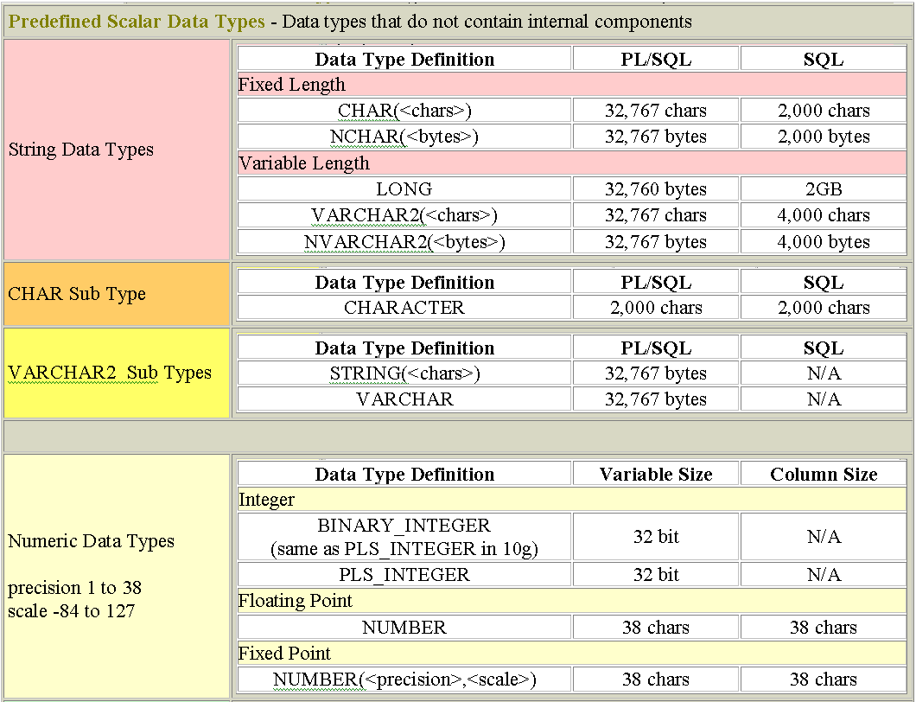

Slide 141
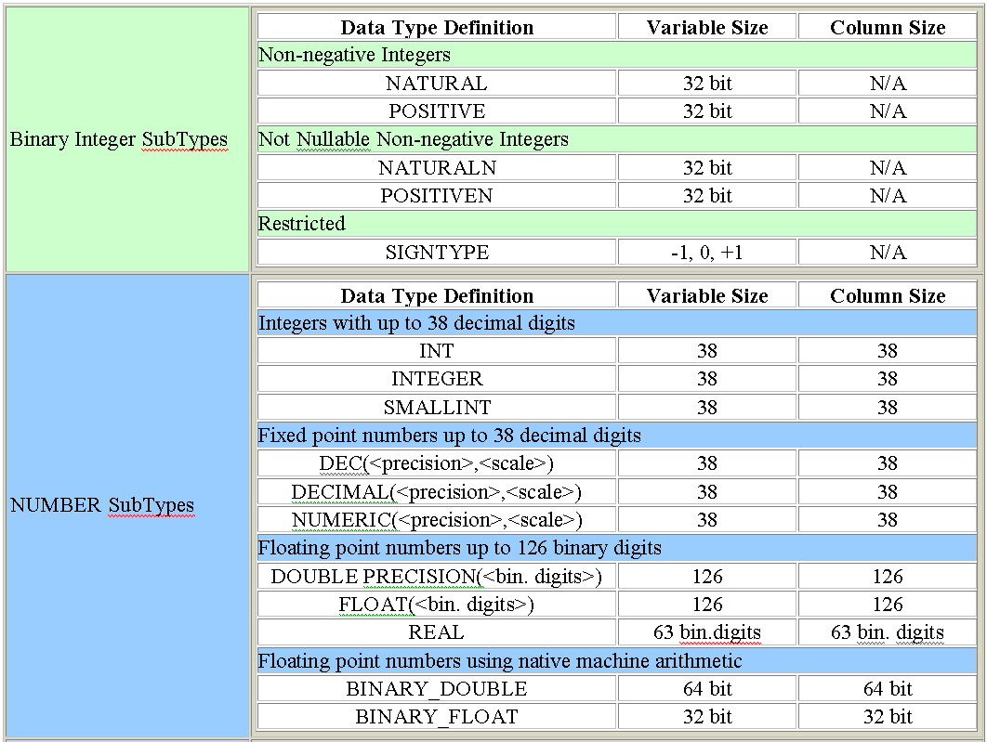

Slide 142
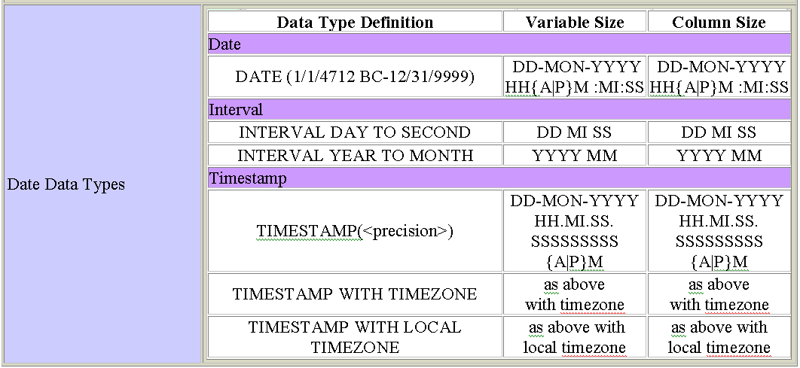

Slide 143
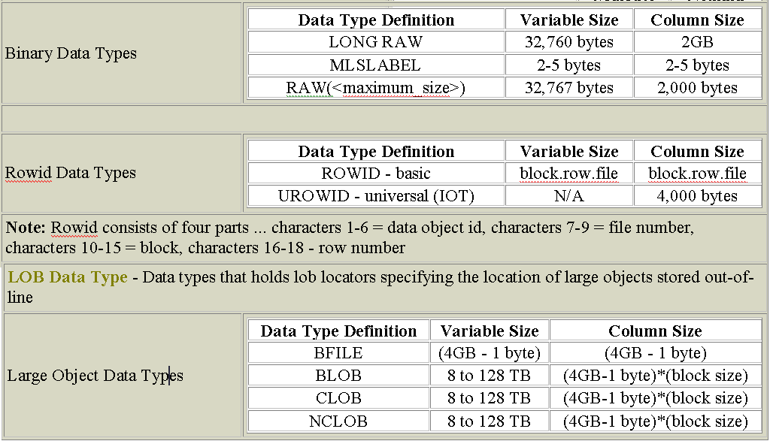

Slide 144
Types of constraints
NOT NULL
-Will not allow NULL values
CHECK
-Checks for the given condition
UNIQUE
-Will not allow duplicate values. NULL’s are allowed
PRIMARY KEY
-Will not allow duplicate values and NULL’s are not allowed
FOREIGN KEY
-A column value which is derived from PRIMARY KEY/UNIQUE column of same/another table.

Slide 145
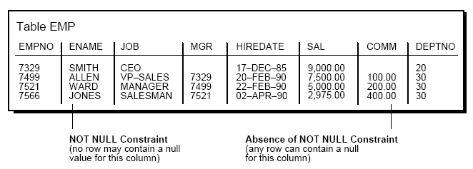
NOT NULL & CHECK Constraints
By default, all columns can contain nulls.
Define NOT NULL constraints for columns of a table that absolutely require values at all times.
CHECK(SAL<=9000)

Slide 146
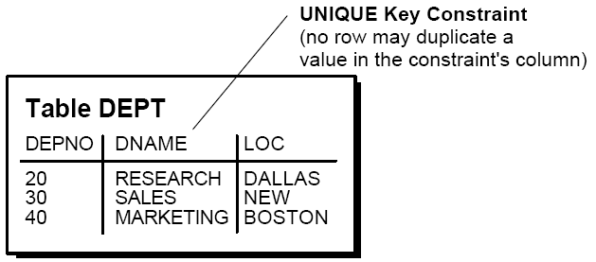
Use UNIQUE Key Integrity Constraints
Unique key constraints are appropriate for any column where duplicate values are not allowed.

Slide 147
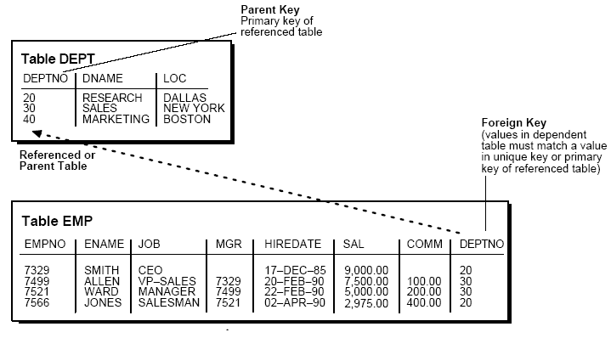
Primary Key
Each table can have one primary key, which uniquely identifies each row in a table and ensures that no duplicate rows exist.

Slide 148
Creating DEPT & EMP table with all the Constraints
CREATE TABLE dept(
deptno NUMBER(2) CONSTRAINT dept_pk PRIMARY KEY,
dname VARCHAR2(12),
loc VARCHAR2(10),
CONSTRAINT dept_unq UNIQUE (dname,loc)
);

Slide 149
CREATE TABLE emp
(empno NUMBER(4) CONSTRAINT emp_pk PRIMARY KEY,
ename VARCHAR2(12) NOT NULL,
job VARCHAR2(15),
mgr NUMBER(4) CONSTRAINT ref_cons REFERENCES EMP[(EMPNO)]
[ON DELETE CASCADE|ON DELETE SET NULL],
hiredate DATE,
sal NUMBER(9,2) CONSTRAINT chk_sal CHECK(SAL<=5000),
comm NUMBER(6,2),
deptno NUMBER(2),
CONSTRAINT fk_dept_emp FOREIGN KEY (DEPTNO)
references DEPT[(DEPTNO)]
[ON DELETE CASCADE|ON DELETE SET NULL]
);
If “ON DELETE CASCADE” option is not used for EMP table and when we try to delete any department in which an employee is in then it is not permitted.
On using “ON DELETE CASCADE” all the corresponding employee records will be deleted automatically if any department is deleted in which an employee is in.

Slide 150
Set Foreign Keys to Null When Parent Key Deleted
When referenced data in the parent key is deleted, all rows in the child table that depend on those parent key values have their foreign keys set to null.
ON DELETE SET NULL option is used
Data Dictionary tables /views
USER_CONSTRAINTS
USER_CONS_COLUMNS
To display table structure:
SQL>DESC table_name;

Slide 151
Creating a table with rows from another table
Syntax:
CREATE TABLE table_name
[(column_name,....)]
as
SELECT statement.
Example:
SQL>CREATE TABLE dept30
as
SELECT EMPNO,ENAME,JOB,SAL FROM EMP WHERE DEPTNO=30;
SQL>SELECT * FROM dept30;

Slide 152
ALTERing a TABLE structure
ALTER TABLE table_name
[ADD/MODIFY/DROP](column_spec[column_constraint])[enable/disable]
To add a column:
ALTER TABLE emp
ADD(second_name varchar2(12));
To add a CHECK constraint:
ALTER TABLE emp
ADD(CHECK(SAL <= 5000));
To add a primary key constraint:
ALTER TABLE emp
ADD(CONSTRAINT emp_prim PRIMARY KEY(EMPNO));
To add a Foreign key constraint:
ALTER TABLE emp
ADD CONSTRAINT fk_dept FOREIGN KEY(DEPTNO) REFERENCES DEPT(DEPTNO);

Slide 153
To MODIFY definition of an existing column:
To increase the width of ENAME column to 18 Characters:
ALTER TABLE emp
MODIFY(ename VARCHAR2(18));
Width cannot be decreased when data is existing with pre-oracle9i.
9i & above versions allows you to decrease width but it must be greater than max width of existing data.
To change NULL to NOT NULL
ALTER TABLE emp
MODIFY(job NOT NULL);
To DROP a constraint from the existing table.
To remove a constraint:
ALTER TABLE emp
DROP CONSTRAINT emp_prim;
ALTER TABLE table_name
DROP PRIMARY KEY;

Slide 154
DROPPING A COLUMN
ALTER TABLE <table_name> DROP column <column_name>;
RENAMING A COLUMN (supported only in 9.2 and above versions)
ALTER TABLE <table_name> RENAME column <old_colname> TO <new_colname>
ENABLE/DISABLE clause
ALTER TABLE DEPT
DISABLE CONSTRAINT dept_prim CASCADE;
CASCADE option disables dependent constraints also.
Removing a TABLE
DROP TABLE table_name [CASCADE CONSTRAINTS] [PURGE];
- CASCADE CONSTRAINTS option will drop dependent constraint also
- PURGE option will ensure that dropped table is not placed in RECYCLE BIN

Slide 155
RENAME command : To change the name of a database including TABLES, VIEWS & SNONYMS
Syntax :
RENAME <old_object> TO <new_object>
Example :
SQL > RENAME emp TO employee;
When a table is renamed constraints are also copied to the new table.
TRUNCATE
(To flush the contents of entire table)
Syntax: TRUNCATE TABLE <table_name>

Slide 156
Adding, Making changes and Deleting rows-DML commands
INSERTing new rows into a table:
Syntax:
INSERT INTO table_name[(col1,col2,...)]
VALUES (value1,value2,...);
Examples:
INSERT INTO dept VALUES(50,’MARKETING’,’SAN JOSE’);
Inserting to specific column
INSERT INTO dept (DEPTNO,LOC) VALUES(60,’LONDON’);

Slide 157
Inserting using substitution values:
INSERT INTO DEPT VALUES(&deptno,’&dname’,’&location’);
When the command is run, promps for data everytime.
INSERTing DATE and TIME information:
When inserting a DATE value, in oracle 9i century will be rounded off. If year is <50 it returns century as 20 and if year is >=50 return century as 19.The date also contains time information, which if not specified defaults to midnight (00:00:00). If a DATE needs to be entered with century along with time then TO_DATE function is to be used:
INSERT INTO emp VALUES(....,....,
TO_DATE(‘8/06/2053 10:45PM’,’DD/MM/YYYY HH:MIPM’,
.....,.....);

Slide 158
COPYING ROWS from another TABLE:
INSERT INTO TABLE[(col1,col2,.....)]
SELECT col1,col2,... FROM table [WHERE condition];
UPDATE
(Making changes to existing data)
UPDATE <table_name>
SET col_name=value WHERE condition;
Example:
UPDATE EMP set JOB=‘SALESMAN’,HIREDATE=SYSDATE,
SAL=SAL*1.1 WHERE ENAME=‘SCOTT’;
If WHERE clause is omitted ALL the rows will be updated.

Slide 159
DELETE
(Removing rows from table)
Syntax:
DELETE [FROM] <table_name>
[WHERE condition];
DELETE EMP WHERE ENAME=‘SMITH’;
If WHERE clause is eliminated ALL the rows will be deleted.

Slide 160
TRANSACTION
Transaction is series of one or more changes performed on database tables.
Types of Transactions
DDL transactions
(structural changes)
CREATE,ALTER,DROP,
TRUNCATE, RENAME
Consists of only one DDL statement
No ROLLBACK is possible
Implicitly COMMIT's
END's the transaction
DML transactions
(changes to data)
INSERT,UPDATE,
DELETE,MERGE
Can contain any number of DML statements which oracle treats as single logical unit of work.
ROLLBACK is possible
Needs explicitly to be COMMITTED

Slide 161
TCL commands
COMMIT - To save all DML changes made in the transaction
- END's the transaction
ROLLBACK - To UNDO all DML changes made in the transaction
- END's the transaction
SAVEPOINT - To divide a transaction
- All savepoints are LOST when transaction END's
Transaction BEGIN's when
- DDL or DML is executed
Transaction END's when
- COMMIT
- ROLLBACK
- DDL statement
- LOGOFF
- Error (server/network)

Slide 162
ORACLE LOCKS
Oracle uses locks to control concurrent access to data.
Locks are mechanisms intended to prevent destructive interaction between users accessing Oracle data.
Locks are used to ensure consistency and integrity.
Consistency means that the data a user is viewing or changing is not changed (by other users) until the user is finished with the data.
Integrity means that the database’s data and structures reflect all changes made to them in the correct sequence.

Slide 163
Automatic Locking
Oracle locking is performed automatically and requires no user action.
Implicit locking occurs for SQL statements as necessary, depending on the action requested.
Oracle’s lock manager automatically locks table data at the row level. By locking table data at the rowlevel, contention for the same data is minimized.

Slide 164
Lock Duration
All locks acquired by statements within a transaction are held for the duration of the transaction
DEADLOCK
Trans-1 Trans-2
SQL> UPDATE EMP SET SQL>UPDATE EMP SET
SAL=1000 WHERE COMM=1000 WHERE
ENAME='SMITH'; EMPNO=7566;
Updated updated
SQL>UPDATE EMP SET SQL>UPDATE EMP SET
SAL=2000 WHERE JOB=‘MANAGER’
ENAME=‘JONES’; WHERE EMPNO=7369;
Deadlock is automatically detected by oracle and will undo one of the transactions and end both the transaction

Slide 165
VIEWS
A view is like a “window” through which data on tables can be viewed or changed.
A view is derived from another table or view which is referred to as the base table of the view.
A view is stored as select statement only. It is a virtual table- i.e a table that does not physically exist but appears to the user as if it exists.
A view has no data of its own. It manipulates data in the underlying base table.

Slide 166
Usefullness of VIEWS
Restricting access to the database: SELECTing from a view can display a restricted portion of database.
Allowing users to make simple queries to retrieve the results from complicated queries.
Types of views:
1. Simple views 2. Complex views
Simple views derive data from only one table. Contains no functions or groups of data.
Complex views are derived from multiple tables and/or may contain functions or groups of data.

Slide 167
Syntax:
CREATE [OR REPLACE] [FORCE|NOFORCE] VIEW view
[(alias[, alias]...)]
AS subquery
[WITH CHECK OPTION [CONSTRAINT constraint]]
[WITH READ ONLY [CONSTRAINT constraint]];
Example: Simple view
SQL> CREATE VIEW DEPT10VIEW
2 AS
3 SELECT EMPNO,ENAME,SAL
4 FROM EMP
5 WHERE DEPTNO=10
6 WITH CHECK OPTION;
View created.
SQL> SELECT * FROM DEPT10VIEW;

Slide 168
Complex view:
SQL>CREATE VIEW DEPT_SUMMARY
2 (DEPTNAME,MINSAL,MAXSAL,AVGSAL)
3 AS
4 SELECT DNAME,MIN(SAL),MAX(SAL),AVG(SAL)
5 FROM EMP,DEPT
6 WHERE EMP.DEPTNO=DEPT.DEPTNO
7* GROUP BY DNAME;
View created.
SQL> SELECT * FROM DEPT_SUMMARY;
DEPTNAME MINSAL MAXSAL AVGSAL
-------------- ---------- ---------- ----------
ACCOUNTING 1300 5000 2916.66667
RESEARCH 800 3000 2175
SALES 950 2850 1566.66667

Slide 169
Sequences
The sequence generator generates sequential numbers, which can help to generate unique primary keys automatically.
Sequences eliminate serialization (programmatically) and improve the concurrency of your application.
Creating sequences
CREATE SEQUENCE MYSEQ
START WITH 5
INCREMENT BY 1
MINVALUE 0
MAXVALUE 10
CYCLE
CACHE 5

Slide 170
The NOCYCLE option indicates that the sequence cannot generate more values after reaching its maximum or minimum value.
The CACHE option of the CREATE SEQUENCE command pre-allocates a set of sequence numbers and keeps them in memory so that they can be accessed faster. When the last of the sequence numbers in the cache have been used, another set of numbers is read into the cache.
Altering Sequences
ALTER SEQUENCE myseq
INCREMENT BY 10
MAXVALUE 100
NOCYCLE
CACHE 20;

Slide 171
Referencing a Sequence
Pseudocolumns NEXTVAL and CURRVAL are used
NEXTVAL -Each new sequence number is generated
CURRVAL-while the current sequence number can be repeatedly referenced.
NEXTVAL and CURRVAL can be used as pseudo-column names in SQL statements such as SELECTs, INSERTs, or UPDATEs.
*examples to be given
Dropping Sequences
DROP SEQUENCE sequence_name;

Slide 172
Synonyms
A synonym is an alias for a table, view, snapshot, sequence, procedure, function, package, or object type.
Synonyms let you refer to objects from other schemas without including the schema qualifier.
CREATE [PUBLIC] SYNONYM synonym_name FOR user.table;
Data dictionary table - user_synonyms
Dropping Synonyms
DROP SYNONYM synonym_name

Slide 173
Indexes
Indexes are used in Oracle to provide quick access to rows in a table.
Create an index when:
 | A column contains a wide range of values
 | A column contains a large number of null values
 | One or more columns are frequently used together in a WHERE clause or a join condition
 | The table is large and most queries are expected to retrieve less than 2% to 4% of the rows in the table
Do not create an index when:
 | The columns are not often used as a condition in the query
 | The table is small or most queries are expected to retrieve more than 2% to 4% of the rows in the table
 | The table is updated frequently
 | The indexed columns are referenced as part of an expression

Slide 174
Creating index
CREATE INDEX index_name ON table_name(col_name,col_name)
CREATE INDEX emp_ind ON emp(ename)
SELECT * FROM EMP WHERE ENAME='SMITH';
Dropping Index
DROP INDEX index_name;
Data dictionary table : user_indexes

Slide 175
Oracle 10g Database Server
PL/SQL

Slide 176
Procedural Language/Structured Query Language
PL/SQL is the procedural extension to SQL with design features of programming languages.
Data manipulation and query statements of SQL are included within procedural units of code.

Slide 177
PL/SQL Block Structure
DECLARE (Optional)
  Variables, cursors, user-defined exceptions
BEGIN (Mandatory)
  SQL statements
  PL/SQL statements
EXCEPTION (Optional)
  Actions to perform when errors occur
END; (Mandatory)
…
DECLARE
…
BEGIN
…
EXCEPTION
END;

Slide 178
Block Types
Anonymous Procedure Function
[DECLARE]
BEGIN
--statements
[EXCEPTION]
END;
PROCEDURE name
IS
BEGIN
--statements
[EXCEPTION]
END;
FUNCTION name
RETURN datatype
IS
BEGIN
--statements
RETURN value;
[EXCEPTION]
END;

Slide 179
Variables
Variables are used to store values/data, for reusability, ease of maintenance using type attributes.
Types of Variables
PL/SQL variables:
  Scalar
  Composite
  Reference
  LOB (large objects)
Non-PL/SQL variables: Bind and host variables

Slide 180
Types of Variables
Scalar data types hold a single value (correspond to column types in Oracle server tables). PL/SQL also supports Boolean variables.
Composite data types, such as records, allow groups of fields to be defined.
Reference data types hold values, called pointers, that designate other program items.
LOB data types hold values, called locators, that specify the location of large objects (such as graphic images) that are stored out of line.
Non-PL/SQL variables include host language variables declared in precompiler programs, screen fields in Forms applications, and SQL*Plus/iSQL*Plus host variables.

Slide 185
Declaring PL/SQL Variables
Syntax :
identifier [CONSTANT]* datatype [NOT NULL]*
[:= | DEFAULT expr];
* value must be assigned while declaring
Example :
DECLARE
v_hiredate DATE;
v_deptno NUMBER(2) NOT NULL := 10;
v_location VARCHAR2(13) := 'Atlanta';
c_comm CONSTANT NUMBER := 1400;
v_mgr NUMBER(6) DEFAULT 100;
The names of the variables must not be longer than 30 characters.
Adopt a naming convention for PL/SQL identifiers:
for example, v_variablename

Slide 186
Pre -Defined Subtypes
PL/SQL predefines several subtypes in package STANDARD.
For example, PL/SQL predefines the subtypes CHARACTER and INTEGER as follows:
SUBTYPE CHARACTER IS CHAR;
SUBTYPE INTEGER IS NUMBER(38,0);
Defining Subtypes
SUBTYPE subtype_name IS base_type[(constraint)] [NOT NULL];

Slide 187
Boolean Type
BOOLEAN- stores logical values TRUE, FALSE, and NULL
You cannot insert the values TRUE and FALSE into a database column.
Also, you cannot select or fetch column values into a BOOLEAN variable.

Slide 188

Composite Data Types
TRUE 23-DEC-98 ATLANTA
PL/SQL table structure
PL/SQL table structure
1 SMITH
2 JONES
3 NANCY
4 TIM
1 5000
2 2345
3 12
4 3456
VARCHAR2
NUMBER
BINARY_INTEGER
BINARY_INTEGER

Slide 189
DBMS_OUTPUT Package
Package DBMS_OUTPUT enables you to display output from PL/SQL blocks and subprograms.
The procedure put_line outputs information to a buffer in the SGA. You display the information by setting SERVEROUTPUT ON in SQL*Plus.
SQL> SET SERVEROUTPUT ON
SQL> BEGIN
2 DBMS_OUTPUT.PUT_LINE(‘Hello World');
3 END;
4 /
Hello World
PL/SQL procedure successfully completed.

Slide 190
SQL>DECLARE
2 X integer;
3 BEGIN
4 X:=5000;
5 DBMS_OUTPUT.PUT_LINE('The value of X='||X);
6 END;
7 /
The value of X=5000
*Examples to be covered:
Scope of an object

Slide 191
New datatypes
BINARY_FLOAT & BINARY_DOUBLE
DECLARE
l_binary_float BINARY_FLOAT;
l_binary_double BINARY_DOUBLE;
BEGIN
l_binary_float := 1.1f;
l_binary_double := 1.00001d;
l_binary_float := TO_BINARY_FLOAT(1.1);
l_binary_double := TO_BINARY_DOUBLE(1.00001);
dbms_output.put_line(l_binary_float||','||l_binary_double);
END;
/

Slide 192
PL/SQL Control Structures
IF-THEN Statement
IF condition THEN
sequence_of_statements;
END IF;
IF-THEN-ELSE Statement
IF condition THEN
sequence_of_statements1;
ELSE
sequence_of_statements2;
END IF;
IF-THEN-ELSIF Statement
IF condition1 THEN
sequence_of_statements1
ELSIF condition2 THEN
sequence_of_statements2
ELSE
sequence_of_statements3
END IF;

Slide 193
Sequential Control – GOTO statement
The GOTO statement lets you branch to a label unconditionally.
BEGIN
...
GOTO insert_row;
...
<<insert_row>>
INSERT INTO emp VALUES ...
END;

Slide 194
CASE Statement
[<<label_name>>]
CASE selector
WHEN expression1 THEN sequence_of_statements1;
...
WHEN expressionN THEN sequence_of_statementsN;
[ELSE sequence_of_statementsN+1;]
END CASE [label_name];
DECLARE
grade CHAR:=&grade;
BEGIN
CASE grade
WHEN 'A' THEN dbms_output.put_line('Excellent');
WHEN 'B' THEN dbms_output.put_line('Very Good');
WHEN 'C' THEN dbms_output.put_line('Good');
WHEN 'D' THEN dbms_output.put_line('Fair');
ELSE dbms_output.put_line('No such grade');
END CASE;
END;

Slide 195
Searched CASE Statement
[<<label_name>>]
CASE
WHEN search_condition1 THEN statements1;
...
WHEN search_conditionN THEN statementsN;
[ELSE sequence_of_statementsN+1;]
END CASE [label_name];
DECLARE
grade CHAR:=&grade;
BEGIN
CASE
WHEN grade='A' THEN dbms_output.put_line('Excellent');
WHEN grade='B' THEN dbms_output.put_line('Very Good');
WHEN grade='C' THEN dbms_output.put_line('Good');
WHEN grade='D' THEN dbms_output.put_line('Fair');
ELSE dbms_output.put_line('No such grade');
END CASE;
END;

Slide 196
Iterative Control: LOOP Statements
There are three forms of LOOP statements: LOOP, WHILE-LOOP, and FOR-LOOP.
CREATE TABLE AREAS(
radius NUMBER(5),
area NUMBER(14,2));
SIMPLE LOOP
LOOP
sequence_of_statements;
END LOOP;

Slide 197
DECLARE
pi CONSTANT NUMBER(9,7):=3.1415927;
radius INTEGER(5);
area NUMBER(14,2);
BEGIN
radius:=3;
LOOP
area:=pi*power(radius,2);
INSERT INTO AREAS VALUES(radius,area);
radius:=radius+1;
IF area > 100 THEN
EXIT; EXIT WHEN area > 100;
END IF;
END LOOP;
END;

Slide 198
WHILE-LOOP
WHILE condition LOOP
sequence_of_statements
END LOOP;
DECLARE
pi CONSTANT NUMBER(9,7):=3.1415927;
radius INTEGER(5);
area NUMBER(14,2);
BEGIN
radius:=3;
WHILE radius <= 7 LOOP
area:=pi*power(radius,2);
INSERT INTO AREAS VALUES(radius,area);
radius:=radius+1;
END LOOP;
END;

Slide 199
FOR-LOOP
FOR counter IN [REVERSE] lower_bound..higher_bound LOOP
sequence_of_statements
END LOOP;
DECLARE
pi CONSTANT NUMBER(9,7):=3.1415927;
area NUMBER(14,2);
BEGIN
FOR radius IN 1..7 LOOP
area:=pi*power(radius,2);
INSERT INTO AREAS VALUES(radius,area);
END LOOP;
END;

Slide 200
NULL Statement
The NULL statement does nothing other than pass control to the next statement.

Slide 201
Interacting with the Oracle Server
SELECT .. INTO .. Statement
-retrieves data from one or more database tables, then assigns the selected values into variables
*To be explained with example

Slide 202
Non PL/SQL Variables
SQL *PLUS BIND VARIABLES
These are host variables that may be used to pass runtime values into or out of PL/SQL block.
Bind variables are declared in SQL *PLUS
VARIABLE variable_name [NUMBER | CHAR | CHAR(N) | VARCHAR2(N)|REFCURSOR|…]
Ex: VARIABLE empname VARCHAR2(12)
*To be explained with example with PRINT command

Slide 203
Declaring Variables based on database columns
DECLARE
empname EMP.ENAME%TYPE;
….
%TYPE attribute enables you to define a variable based on a table column datatype
% is attribute indicator.
PL/SQL Record Variables
A record is a group of related data items stored in fields, each with its own name and datatype.
These items are logically related but dissimilar in type.
A record containing a field for each item lets you treat the data as a logical unit.
To create records, you define a RECORD type, then declare records of that type.

Slide 204
PL/SQL Record Structure
Field1 (data type) Field2 (data type) Field3 (data type)
Example:
Field1 (data type) Field2 (data type) Field3 (data type)
dept_id number(2) dept_name varchar2(14) dept_loc varchar2(13)
10 ACCOUNTING NEW YORK

Slide 205
Syntax
Note : RECORD types cannot be CREATEd and stored in the database.
You can use %TYPE and %ROWTYPE to specify field types. In the following example, you define a RECORD type named DeptRec:
TYPE DeptRectype IS RECORD (
dept_id dept.deptno%TYPE, dept_name VARCHAR2(14),
dept_loc VARCHAR2(13));
TYPE type_name IS RECORD
(field_declaration[, field_declaration]…);
identifier type_name;
field_name {field_type | variable%TYPE
| table.column%TYPE | table%ROWTYPE}
[[NOT NULL] {:= | DEFAULT} expr]

Slide 206
Declaring a record variable
dept_rec deptrectype;
To access individual fields
dept_rec.dept_id;
dept_rec.dept_name;
*example on recordtype
Record variables based on tables
It means that each field in the record has the same name and datatype as the columns in the specified table.
%ROWTYPE attribute is used to facilitate the declaration of a record based on a table.
emprec EMP%ROWTYPE;
* example on rowtype
* Retired employees example.

Slide 207
PL/SQL Error Handling
In PL/SQL, a warning or error condition is called an exception.
An exception is an identifier in PL/SQL that is raised during the execution of a block that terminates its main body of actions. A block always terminates when PL/SQL raises an exception, but can you specify an exception handler to perform final actions.
Examples of internally defined exceptions include no data found, fetching multiple rows, value error, division by zero, out of memory and many more.
For example, if the error ORA-01403 occurs when no rows are retrieved from the database in a SELECT statement, then PL/SQL raises the exception NO_DATA_FOUND.

Slide 208
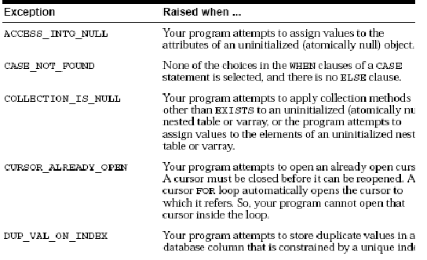
Predefined Exception raised when…

Slide 209
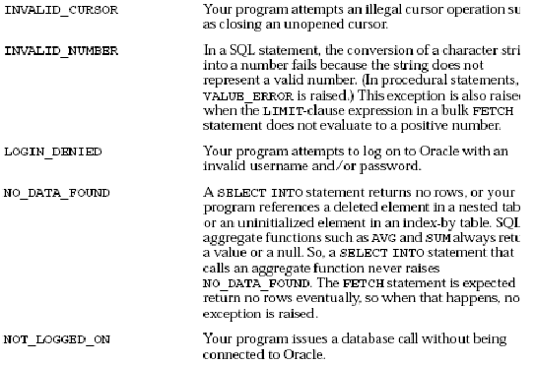

Slide 210
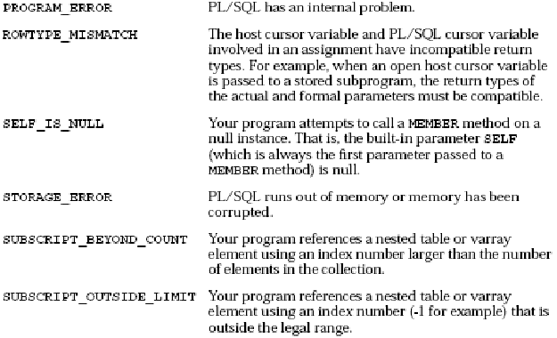

Slide 211
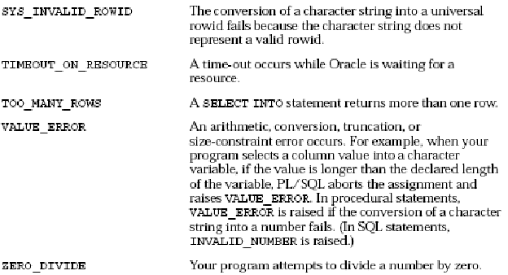

Slide 212
Handling Exceptions
Trap the exception
Propagate the exception
DECLARE
DECLARE
BEGIN
BEGIN
Exception
is raised
Exception
is raised
EXCEPTION
EXCEPTION
Exception
is trapped
Exception is not trapped
END;
END;
Exception propagates to calling environment

Slide 213
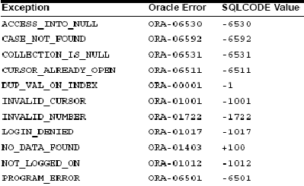
Predefined Exception Handler

Slide 214
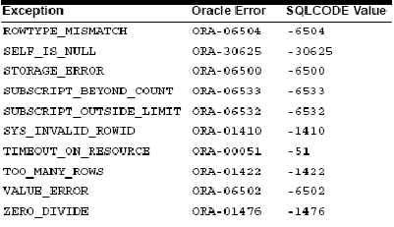

Slide 215
*Examples to be given for no_data_found,too_many_rows,value_error
OTHERS EXCEPTION HANDLER
Can be used as a generic exception handler.
SQLCODE & SQLERRM Functions
SQLCODE returns the number of the Oracle error for internal exceptions. You can pass an error number to SQLERRM, which then returns the message associated with the error number.

Slide 216
Procedure RAISE_APPLICATION_ERROR
The procedure RAISE_APPLICATION_ERROR lets you issue user-defined ORAerror messages from stored subprograms. That way, you can report errors to your application and avoid returning unhandled exceptions.
raise_application_error(error_number, message[, {TRUE | FALSE}]);
error_number is a negative integer in the range -20000 .. -20999
message is a character string up to 2048 bytes long.
If TRUE, the error is placed on the stack of previous errors.
If FALSE (the default), the error replaces all previous errors.

Slide 217
RAISE_APPLICATION_ERROR is part of package DBMS_STANDARD, and as with package STANDARD, you do not need to qualify references to it.
An application can call raise_application_error only from an executing stored subprogram (or method).
When called, raise_application_error ends the subprogram and returns a user-defined error number and message to the application.
The error number and message can be trapped like any Oracle error.
*will be discussed in procedures and triggers topic

Slide 218
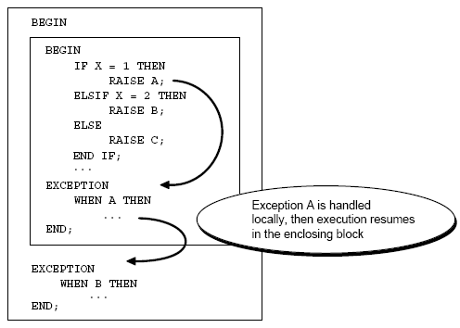
How PL/SQL Exceptions Propagate

Slide 219
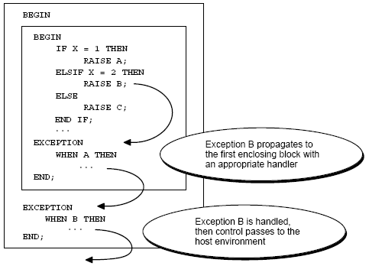

Slide 220
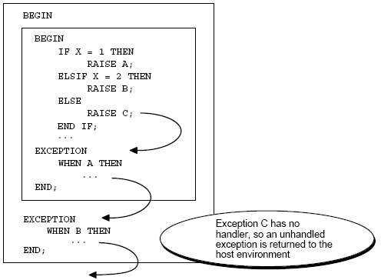

Slide 221
CURSOR’s
Whenever you issue a SQL statement, the Oracle server opens an area of memory in which the command is parsed and executed. This area is called a cursor.
Types of cursor's
1.IMPLICIT cursor
-automatically defined by oracle
-INSERT/UPDATE/DELETE
-SELECT INTO statement which returns single row
-Name: SQL
2.EXPLICIT cursor
-user defined cursors
-SELECT statement which returns zero or more rows
-Name: user-defined cursor name

Slide 222
Controlling Explicit Cursors
No
DECLARE
OPEN
FETCH
Yes
CLOSE
EMPTY?
Create a named SQL area
Identify the active set
Load the current row into variables
Test for existing rows
Release the active set
Return to FETCH if rows are found

Slide 223
Declaring a Cursor
When you declare a cursor, you name it and associate it with a specific query. When you declare a cursor oracle names an area of memory in server and associates select statement with the cursor location.
At this stage, the query is parsed (cols, tables etc., are validated) but it is not executed.
CURSOR cursor_name [(parameter[, parameter]...)]
[RETURN return_type] IS select_statement;
Ex:
cursor emp_cur is
select ename,sal,hiredate,deptno from emp where deptno=20;

Slide 224
OPENing the Cursor
Opening the cursor executes the query and identifies the result set, which consists of all rows that meet the query search criteria.
For cursors declared using the FOR UPDATE clause, the OPEN statement also locks those rows.
OPEN cursor_name;
Ex:OPEN emp_cur;
OPEN c1(emplname, 3000);
OPEN c1(‘SMITH’, 1500);
OPEN c1(emplname, esal);

Slide 225
Fetching with a Cursor
The FETCH statement retrieves the rows in the result set one at a time. Each fetch retrieves the current row and then advances the cursor to the next row in the result set.
FETCH cursor_name INTO var1,var2,.. or record_list;
Ex:
FETCH c1 INTO my_empno, my_ename, my_deptno;
LOOP
FETCH c1 INTO my_record;
EXIT WHEN c1%NOTFOUND;
-- process data record
END LOOP;

Slide 226
Closing a Cursor
The CLOSE statement disables the cursor, and the result set becomes undefined.
Once a cursor is closed, you can reopen it. Any other operation on a closed cursor raises the predefined exception INVALID_CURSOR.
CLOSE cursor_name;
Ex:
CLOSE emp_cur;

Slide 227
CURSOR attributes
- returns status of the cursor
ATTRIBUTE | IMPLICIT cursor | EXPLICIT cursor
%FOUND | -returns TRUE if last statement is successful | -returns TRUE if LAST FETCH is successful
%NOTFOUND | -complements %found attribute
%ISOPEN | -always returns FALSE since cursor is implicitly closed | -returns TRUE if cursor is open
%ROWCOUNT | -returns number of rows processed

Slide 228
CURSOR FOR loop:
PL/SQL provides a special kind of FOR loop to process the rows returned in an explicit CURSOR.
In a CURSOR FOR loop, a declared CURSOR is OPENed, FETCHed from and CLOSEed automatically when all of the rows have be processed.
Each iteration of the loop fetches a row from the active set into a record, which is implicitly declared for use within the loop.
The loop is terminated automatically at the end of the iteration when the last row was FETCHed.

Slide 229
PL/SQL Subprograms
Subprograms are named PL/SQL blocks that can take parameters and be invoked.
PL/SQL has two types of subprograms called procedures and functions.
Procedures are used to perform an action
Functions are used to compute a value.
subprograms have a declarative part, an executable part, and an optional exception-handling part.
The declarative part contains declarations of types, cursors, constants, variables, exceptions, and nested subprograms.

Slide 230
Advantages of Subprograms
Extensibility: that is, they let you tailor the PL/SQL language to suit your needs.
Modularity: that is, they let you break a program down into manageable, well-defined modules.
reusability and maintainability: Once validated, a subprogram can be used with confidence in any number of applications. If its definition changes, only the subprogram is affected. This simplifies maintenance.
Abstraction: To use subprograms, you must know what they do, not how they work.

Slide 231
PL/SQL Procedures
Syntax:
[CREATE [OR REPLACE]]
PROCEDURE [schema.]name [( parameter [, parameter ...] ) ] [AUTHID DEFINER | CURRENT_USER]
IS
[declarations]
BEGIN
executable statements
[ EXCEPTION
exception handlers]
END [name];
First 2 lines are procedure specification and rest is procedure body

Slide 232
declarative part is placed between the IS and BEGIN
keyword DECLARE is not used.
Procedures that take no parameters are written without parentheses.
You cannot constrain the datatype of a parameter.
PROCEDURE reconcile (acct_id CHAR(5)) IS ... illegal
However, you can use the following workaround to size-constrain parameter types indirectly:
DECLARE
SUBTYPE Char5 IS CHAR(5);
PROCEDURE reconcile (acct_id Char5) IS ...
where parameter stands for the following syntax:
parameter_name [IN | OUT | IN OUT ] datatype [{:= | DEFAULT} expression]

Slide 233
Procedural Parameter Modes
Procedure
Calling
environment
IN parameter
OUT parameter
IN OUT parameter
procedure …
BEGIN
EXCEPTION
END;

Slide 234
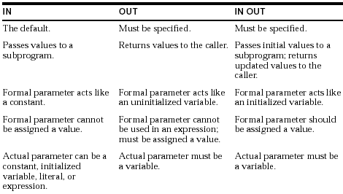

Slide 235
A simple PL/SQL procedure
To increase the salary of employee
CREATE OR REPLACE PROCEDURE raise_salary (emp_id INTEGER, increase REAL) is
BEGIN
UPDATE emp SET sal = sal + increase
WHERE empno = emp_id;
commit;
END raise_salary;
Calling a procedure
SQL> EXECUTE RAISE_SALARY(7369,100);
SQL> begin
2 raise_salary(7369,100);
3 end;
4 /

Slide 236
CREATE PROCEDURE calc_bonus (emp_id IN emp.empno%TYPE, bonus OUT REAL) IS
BEGIN
SELECT sal * 3 INTO bonus FROM emp WHERE
empno = emp_id;
END;
Calling procedure from a PL/SQL block
DECLARE
empid emp.empno%TYPE:=&EMPNO;
bonus NUMBER;
BEGIN
calc_bonus(empid,bonus);
dbms_output.put_line('Bonus='||bonus);
END;

Slide 237
Default Values for Subprogram Parameters
PROCEDURE create_dept (dno dept.deptno%type,
new_dname dept.dname%type DEFAULT 'TEMP',
new_loc dept.loc%type VARCHAR2 DEFAULT 'TEMP') IS
BEGIN
INSERT INTO dept
VALUES (dno, new_dname, new_loc);
Commit;
END;
If an actual parameter is not passed, the default value of its corresponding formal parameter is used.
create_dept;
create_dept('MARKETING');
create_dept('MARKETING', 'NEW YORK');

Slide 238
you cannot skip a formal parameter by leaving out its actual parameter.
create_dept('NEW YORK'); -- incorrect
You cannot solve the problem by leaving a placeholder for the actual parameter.
create_dept(, 'NEW YORK'); -- not allowed
In such cases, you must use named notation, as follows:
create_dept(new_loc => 'NEW YORK');
Dropping Procedures
DROP PROCEDURE procedure_name;

Slide 239
PL/SQL Functions
Functions and procedures are structured alike, except that functions have a RETURN clause.
[CREATE [OR REPLACE]]
FUNCTION [schema.]name [( parameter [, parameter ...] ) ]
RETURN return_datatype
[AUTHID DEFINER | CURRENT_USER]
IS
[declaration statements]
BEGIN
executable statements
RETURN <value>;
[EXCEPTION
exception handler statements]
END [ name ];
RETURN Statement
RETURN statement must contain an expression, which is
evaluated when the RETURN statement is executed.

Slide 240
In a function, there must be at least one execution path that leads to a RETURN statement. Otherwise, you get a function returned without value error at run time.
Examples :
A function which returns string in sentence case after accepting a string
CREATE OR REPLACE FUNCTION SENTCASE(STR VARCHAR2)
RETURN VARCHAR2
IS
S VARCHAR2(80);
BEGIN
S:=UPPER(SUBSTR(STR,1,1))||LOWER(SUBSTR(STR,2));
RETURN S;
END;

Slide 241
Calling a function
SELECT SENT_CASE('HOW are YOU now') FROM DUAL;
Dropping Functions
DROP FUNCTION function_name

Slide 242
Comparing Procedures
and Functions
Procedures
Execute as a PL/SQL statement
Do not contain RETURN clause in the header
Can return none, one, or many values
Can contain a RETURN statement
Functions
Invoke as part of an expression
Must contain a RETURN
clause in the header
Must return a single value
Must contain at least one RETURN statement

Slide 243
Packages:
Group logically related PL/SQL types, items, and subprograms
Consist of two parts:
  Specification
  Body
Cannot be invoked, parameterized, or nested
Allow the Oracle server to read multiple objects into memory at once
Overview of Packages

Slide 244
Components of a Package
Public variable
Package
specification
Procedure A
declaration
Public procedure
Private variable
Procedure B
definition
Private procedure
Package
body
Procedure A
definition
Public procedure
Local variable
Note : A package specification can exist without a package body, but a package body cannot exist without a package specification.

Slide 245
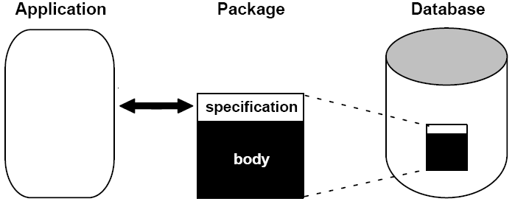
Packages usually have two parts, a specification and a body,
although sometimes the body is unnecessary.
The specification is the interface to your applications; it declares the types, variables, constants, exceptions, cursors, and subprograms available for use.
The body fully defines cursors and subprograms, and so implements the spec.

Slide 246
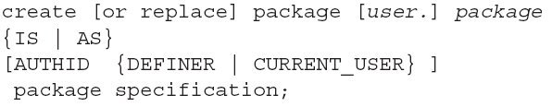

Package Specification
Package Body

Slide 247
Package for handling employees
CREATE OR REPLACE PACKAGE emp_actions AS
PROCEDURE hire_employee (
empno NUMBER,
ename VARCHAR2,
job VARCHAR2,
mgr NUMBER,
sal NUMBER,
comm NUMBER,
deptno NUMBER);
PROCEDURE fire_employee (emp_id NUMBER);
PROCEDURE raise_salary (emp_id INTEGER, increase NUMBER);
END emp_actions;

Slide 248
Package body
CREATE OR REPLACE PACKAGE BODY emp_actions AS PROCEDURE hire_employee (
empno NUMBER,
ename VARCHAR2,
job VARCHAR2,
mgr NUMBER,
sal NUMBER,
comm NUMBER,
deptno NUMBER) IS
BEGIN
INSERT INTO emp VALUES (empno, ename, job, mgr, SYSDATE, sal, comm, deptno);
END hire_employee;
(cont’d)

Slide 249
Package body cont’d…
PROCEDURE fire_employee (emp_id NUMBER) IS
BEGIN
DELETE FROM emp WHERE empno = emp_id;
END fire_employee;
PROCEDURE raise_salary (emp_id INTEGER, increase NUMBER) IS
BEGIN
UPDATE emp SET sal = sal + increase WHERE empno = emp_id;
END raise_salary;
END emp_actions;

Slide 250
Executing Packages
-EXECUTE EMP_ACTIONS.FIRE_EMPLOYEE(7566);
-EXECUTE EMP_ACTIONS.HIRE_EMPLOYEE (1000,'RAJESH','MANAGER',7566,3000,500,10);
-EXECUTE EMP_ACTIONS.RAISE_SALARY(7369,100);
Dropping Packages
- DROP PACKAGE BODY <package_name>
- DROP PACKAGE <package_name>

Slide 251
TRIGGER
A trigger:
Is a PL/SQL block or a PL/SQL procedure associated with a table, view, schema, or the database
Executes implicitly whenever a particular event takes place

Slide 252
USES OF TRIGGERS
Triggers may be used to
supplement declarative referential integrity.
enforce complex business rules.
audit change to data.
monitor database related actions.

Slide 253
CREATE [OR REPLACE] TRIGGER <trigger_name>
BEFORE/AFTER/INSTEAD OF INSERT OR UPDATE OR DELETE
ON <table_name>/<view_name>
[FOR EACH ROW] --default is STATEMENT trigger
[WHEN clause] –-optional condition
[DECLARE
<variables,types,etc>;]
BEGIN
<executable_statements>;
[EXCEPTION
<error handling>;]
END;
Trigger timing
Triggering Event
Trigger Type
Trigger Body

Slide 254
Creating DML Triggers
A triggering statement contains:
Trigger timing
  For table: BEFORE, AFTER
  For view: INSTEAD OF
Triggering event: INSERT/UPDATE/DELETE
Table name: On table, view
Trigger type: Row or statement
WHEN clause: Restricting condition
Trigger body: PL/SQL block

Slide 255
DML Trigger Components
Trigger timing: When should the trigger fire?
BEFORE: Execute the trigger body before the triggering DML event on a table.
AFTER: Execute the trigger body after the triggering DML event on a table.
INSTEAD OF: Execute the trigger body instead of the triggering statement. This is used for views that are not otherwise modifiable.

Slide 256
DML Trigger Components
Triggering user event: Which DML statement causes the trigger to execute?
You can use any of the following:
INSERT
UPDATE
DELETE

Slide 257
DML Trigger Components
Trigger type: Should the trigger body execute for each row the statement affects or only once?
Statement: The trigger body executes once for the triggering event. This is the default. A statement trigger fires once, even if no rows are affected at all.
Row: The trigger body executes once for each row affected by the triggering event. A row trigger is not executed if the triggering event affects no rows.

Slide 258
DML Trigger Components
Trigger body: What action should the trigger perform?
The trigger body is a PL/SQL block or a call to a
procedure.

Slide 259
Syntax for Creating
DML Statement Triggers
Syntax:
CREATE [OR REPLACE] TRIGGER trigger_name
timing
event1 [OR event2 OR event3]
ON table_name
trigger_body
Note: Trigger names must be unique with respect to other triggers in the same schema.

Slide 260
Example:
CREATE OR REPLACE TRIGGER secure_emp
BEFORE INSERT or UPDATE or DELETE ON emp
BEGIN
IF (TO_CHAR(SYSDATE,'DY') IN ('SAT','SUN')) OR
(TO_CHAR(SYSDATE,'HH24:MI') NOT BETWEEN '08:00' AND '18:00')
THEN RAISE_APPLICATION_ERROR (-20500, 'DML allowed only during business hours.');
END IF;
END;
/

Slide 261
Creating a DML Row Trigger
CREATE [OR REPLACE] TRIGGER trigger_name
timing
event1 [OR event2 OR event3]
ON table_name
[REFERENCING OLD AS old | NEW AS new]
FOR EACH ROW
[WHEN (condition)]
trigger_body

Slide 262
Using OLD and NEW Qualifiers
Within a ROW trigger, reference the value of a column before and after the data change by prefixing it with the OLD and NEW qualifier.
  The OLD and NEW qualifiers are available only in ROW triggers.
  Prefix these qualifiers with a colon (:) in every SQL and PL/SQL statement.
  There is no colon (:) prefix if the qualifiers are referenced in the WHEN restricting condition.
Note: Row triggers can decrease the performance if you do a lot of updates on larger tables.

Slide 263
Fires when DML is performed on EMP table
CREATE OR REPLACE TRIGGER Print_salary_changes
BEFORE INSERT OR UPDATE ON Emp
FOR EACH ROW
WHEN (new.Empno > 0)
DECLARE
sal_diff number;
BEGIN
sal_diff := :new.sal - :old.sal;
dbms_output.put_line('Old salary: ' || :old.sal);
dbms_output.put_line(' New salary: ' || :new.sal);
dbms_output.put_line(' Difference ' || sal_diff);
END;

Slide 264
INSTEAD OF Triggers
Application
INSERT INTO my_view
. . .;
INSERT TABLE1
INSTEAD OF Trigger
UPDATE TABLE2
MY_VIEW

Slide 265
Creating an INSTEAD OF Trigger
Syntax:
CREATE [OR REPLACE] TRIGGER trigger_name
INSTEAD OF
event1 [OR event2 OR event3]
ON view_name
[REFERENCING OLD AS old | NEW AS new]
[FOR EACH ROW]
trigger_body

Slide 266
INSTEAD OF Trigger Example
CREATE OR REPLACE VIEW EMPDEPT
AS
SELECT EMPNO,ENAME,JOB,SAL,E.DEPTNO,DNAME,LOC
FROM EMP E,DEPT D
WHERE E.DEPTNO=D.DEPTNO;
CREATE OR REPLACE TRIGGER INSTEADVIEW
INSTEAD OF INSERT ON EMPDEPT
FOR EACH ROW
DECLARE
cnt integer;
BEGIN
IF inserting THEN
select count(*) into cnt from dept where deptno=:new.deptno;
IF cnt=0 THEN
insert into dept values(:NEW.deptno,:NEW.dname,:NEW.loc);
END IF;
insert into emp(empno,ename,job,sal,deptno)
values(:NEW.empno, :NEW.ename,:NEW.job,:NEW.sal, :NEW.deptno);
END IF;
END;

Slide 267
Altering triggers
ALTER TRIGGER trigger_name ENABLE|DISABLE;
ALTER TABLE table_name ENABLE|DISABLE all triggers;
Dropping triggers:
DROP TRIGGER trigger_name;
The following data dictionary views reveal information about triggers:
- USER_TRIGGERS

